Slide 1
The results of the new models differ from the results of the old models in the following ways:
The SST influences are generally smaller
There are fewer sig positive stocks but the same number of sig negative stocks
MSY declined by 4.1% rather than 5.7%; the overlap with zero remains about the same
Patterns among ecoregions remains generally the same
East Asian and the EU ecoregions remain the biggest losers
The NE US Shelf and Baltic Sea moved from slight to significant winners
Labrador-Newfoundland moved from slight negative to significant positive
Patterns among taxonomic families remains generally the same
Gadidae remains sig negative
Ammodytidae and Pectinidae become significantly influenced
The influence of stock characteristics and life history traits becomes a bit more muddled but the trends for overfishing and fast-lived species remains intact
The influence of position in thermal niche also becomes a bit more muddled but remains intact
Specific, but not generic, stock assessment method actually structures the response. I think this is basically another way of measuring "region" though:
VPA = negative, mostly East Asia
TSA = negative, mostly Europe
SMS/SAM = negative, all North Sea
SURBA = positive, all Canada East Coast
SYM = positive, Atlantic scallop stock

Slide 2
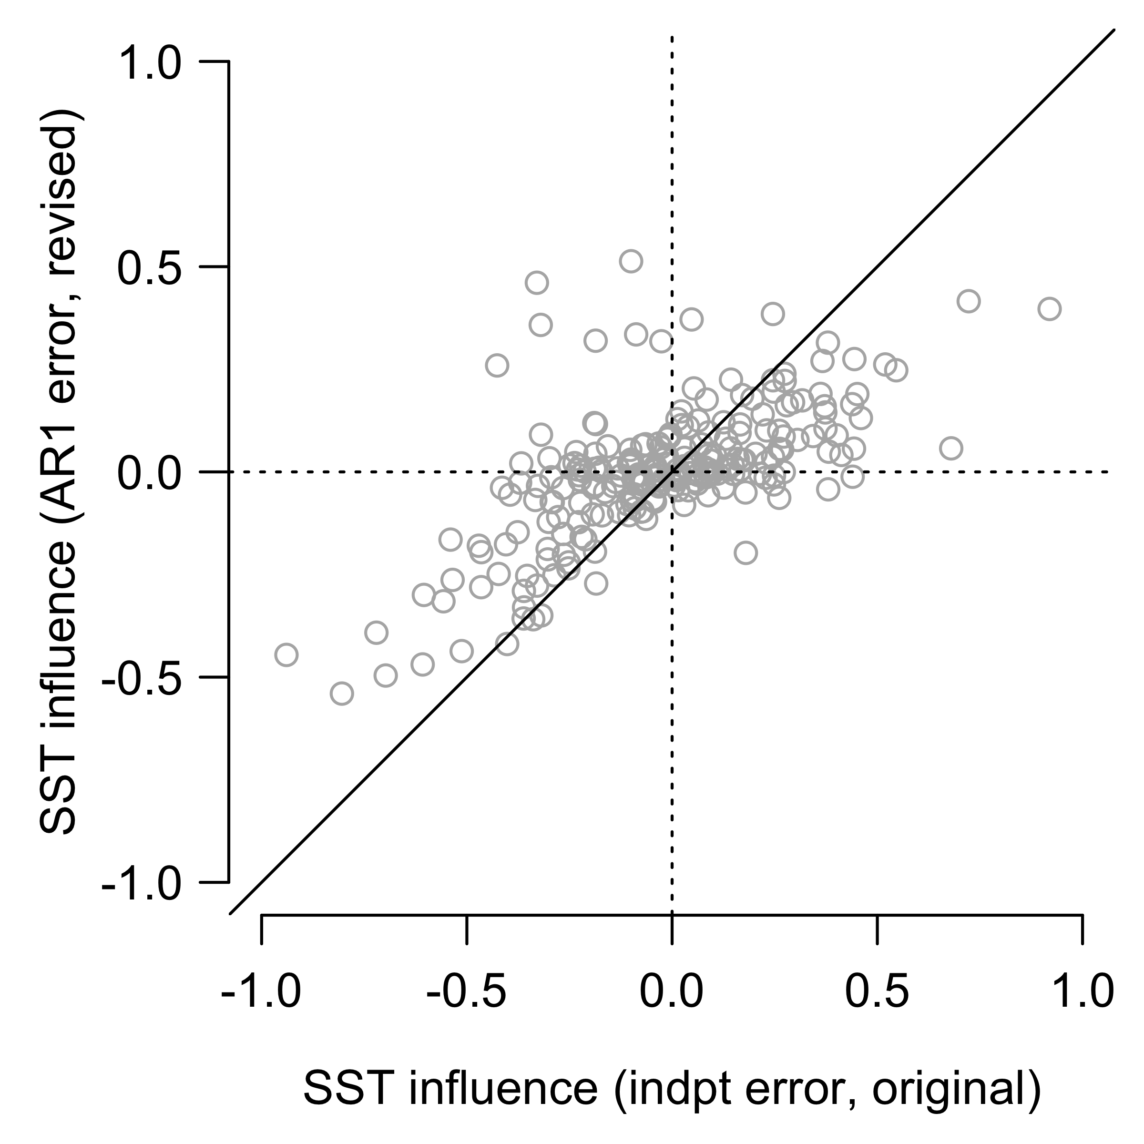
New SST influences (AR1 model) compared to old SST influences

Slide 3
Main text figures

Slide 4
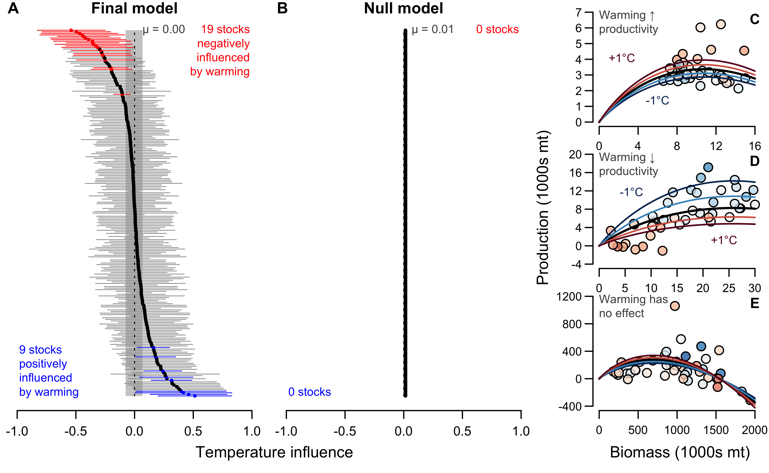

Slide 5
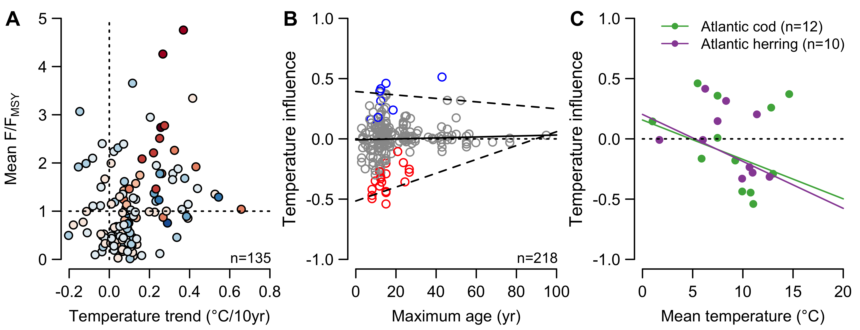

Slide 6
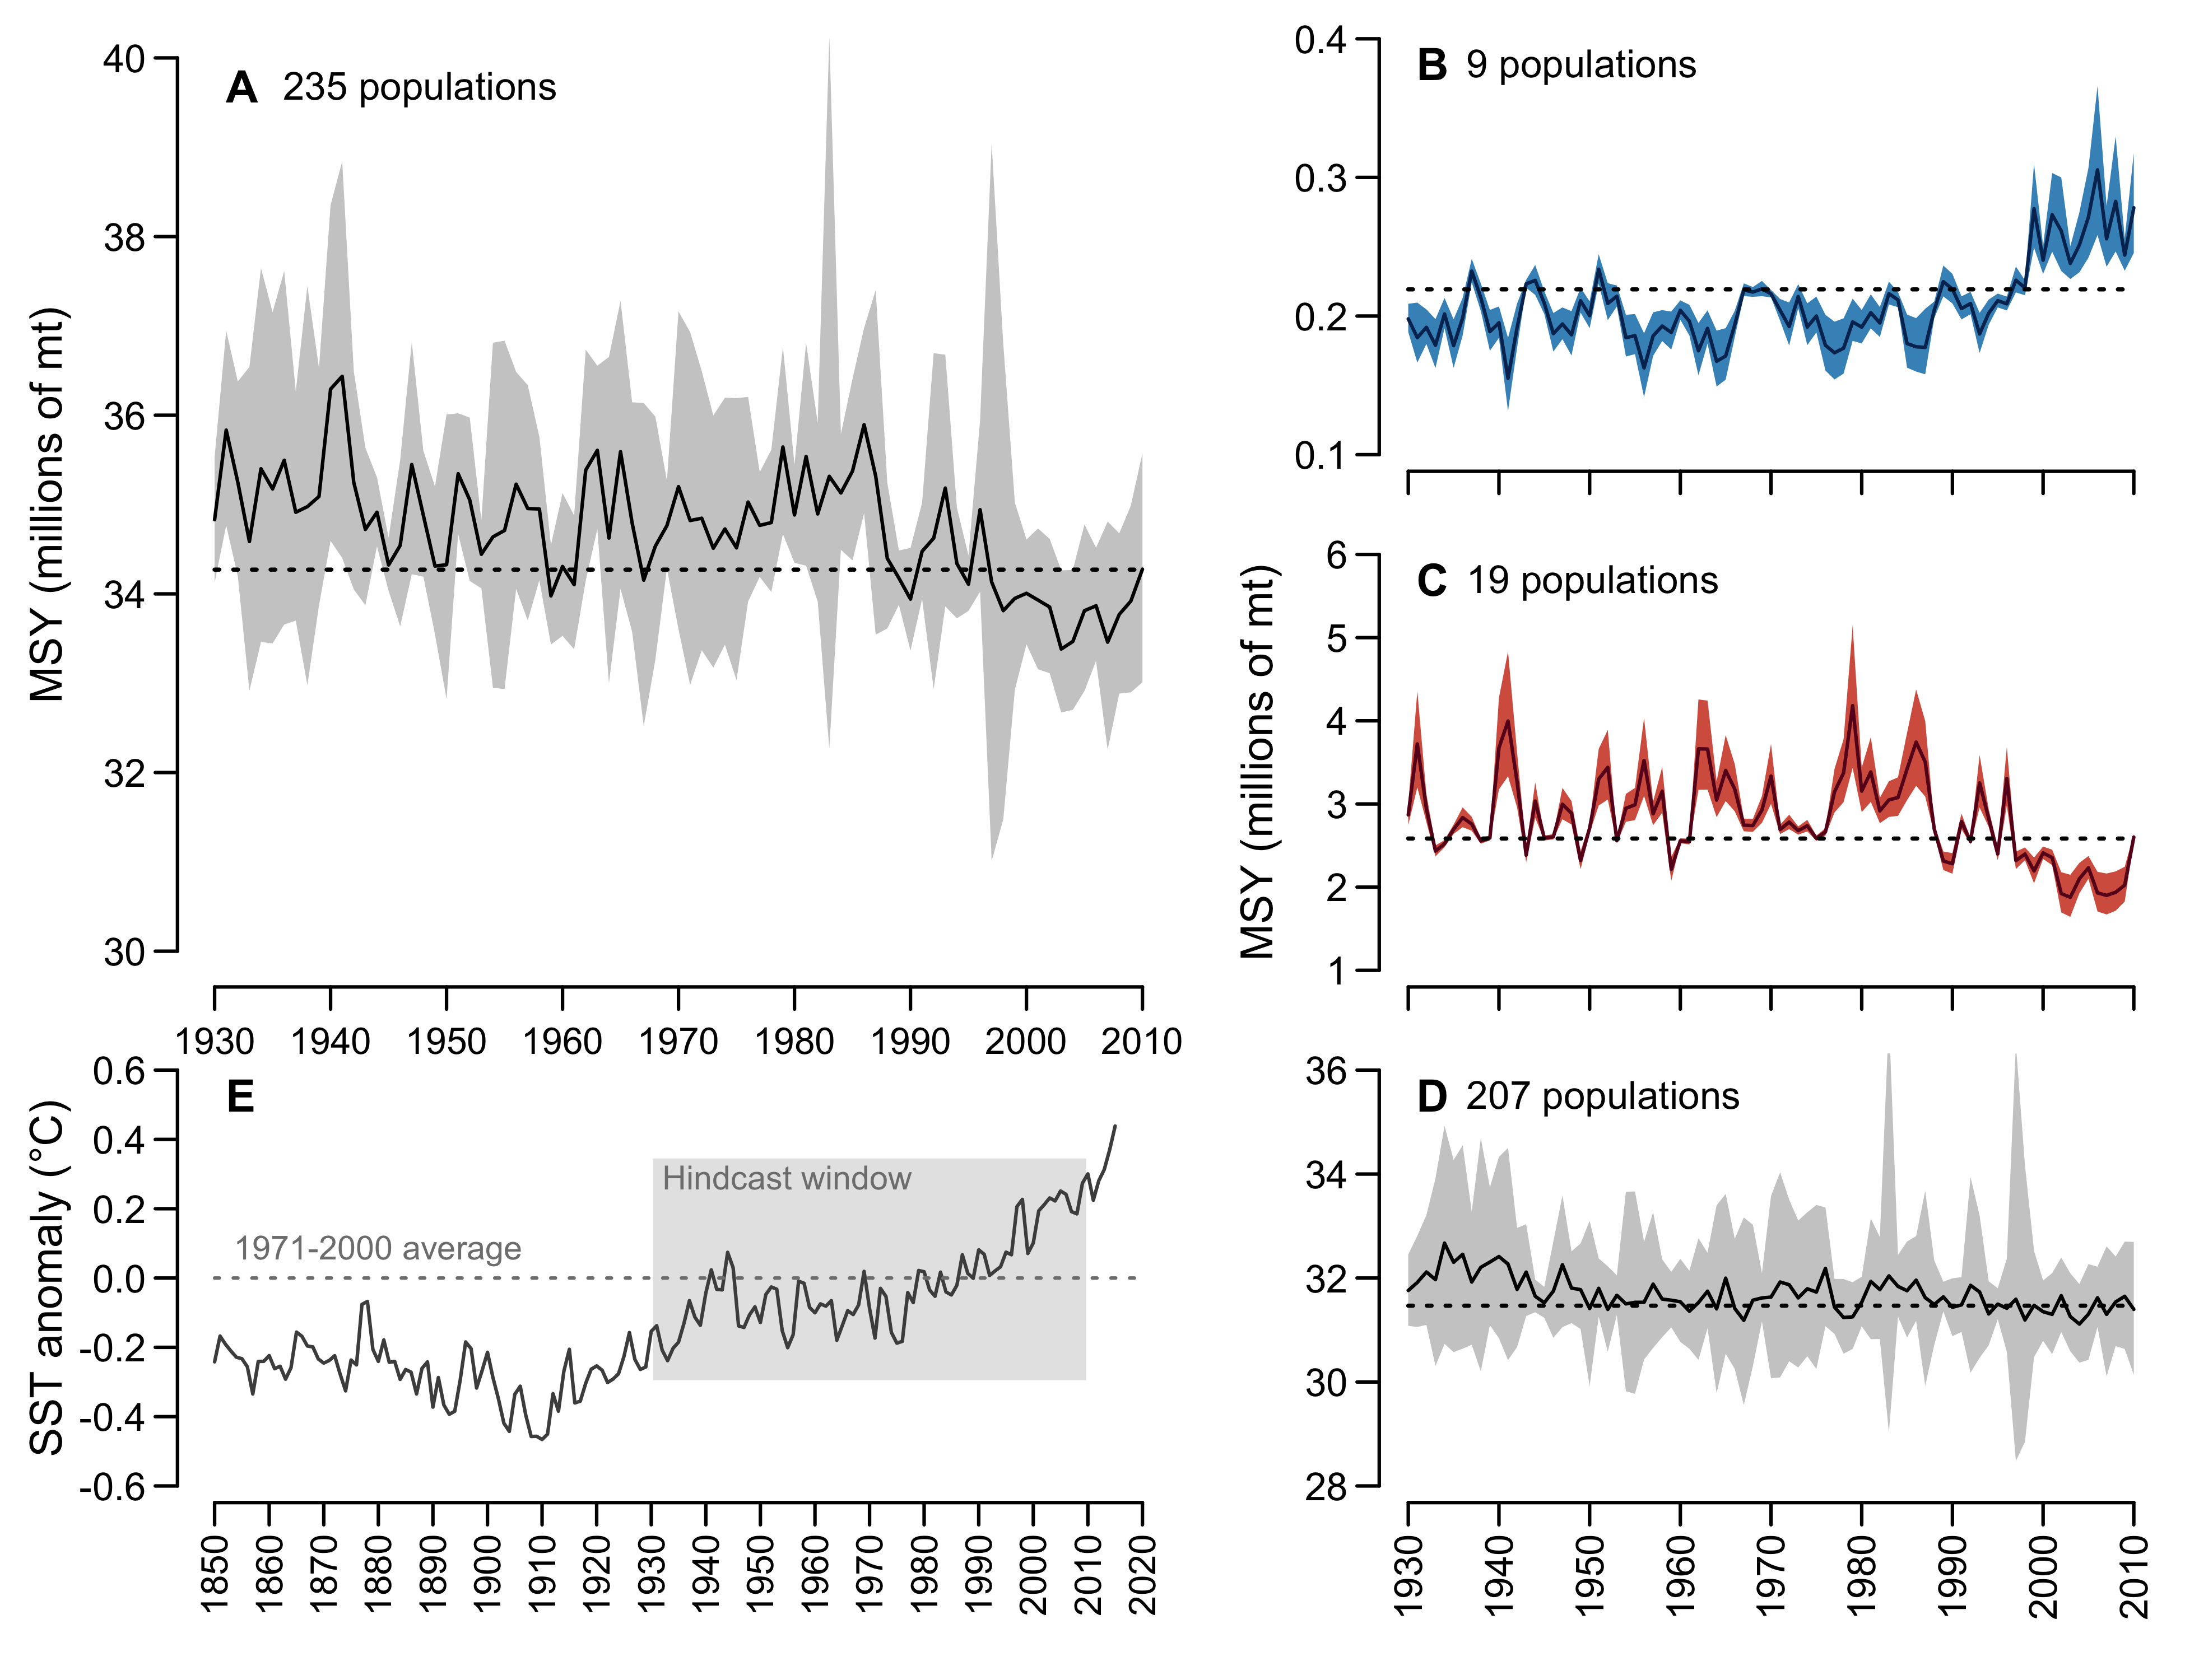

Slide 7
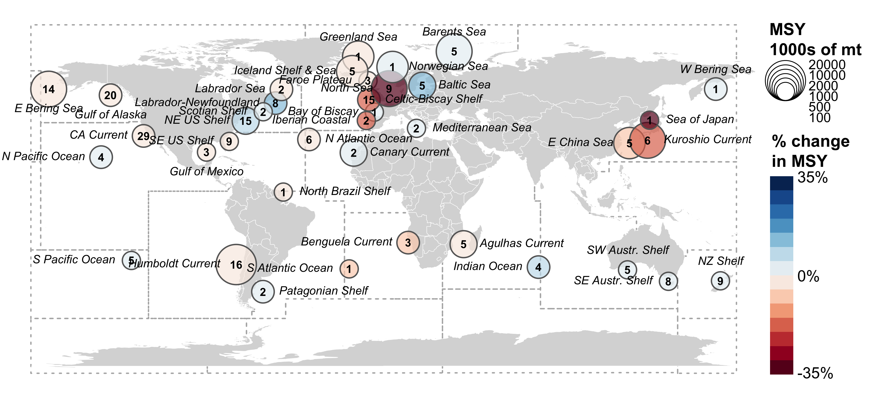

Slide 8
Important table

Slide 9
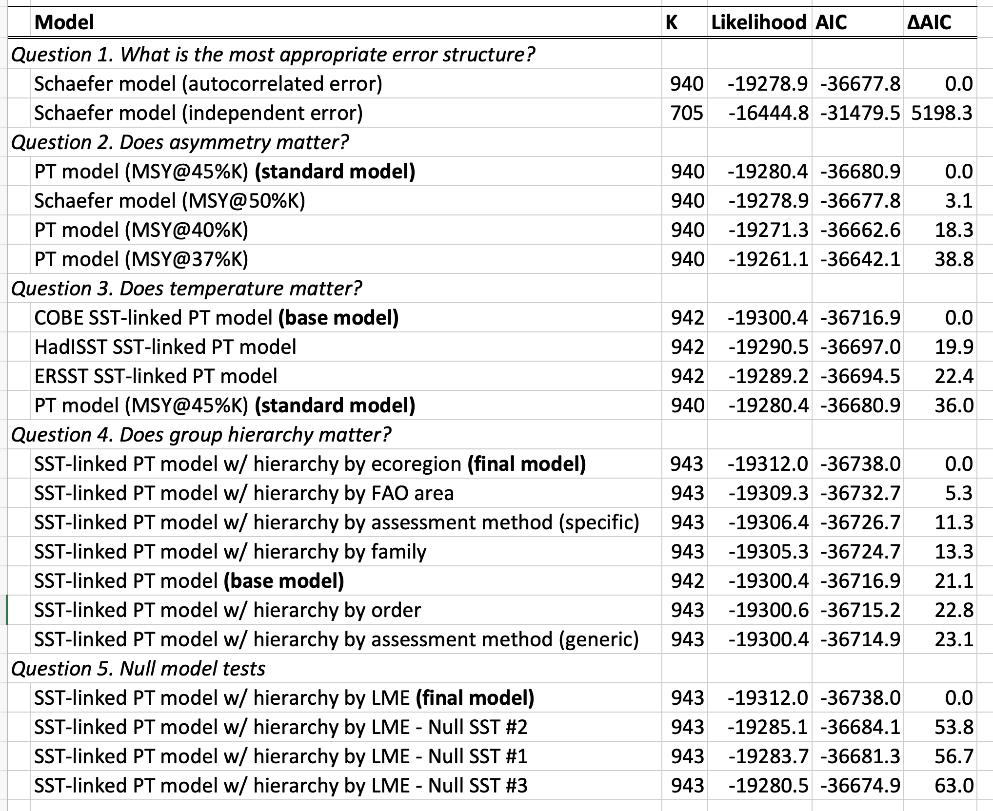

Slide 10
Supplemental figures

Slide 11
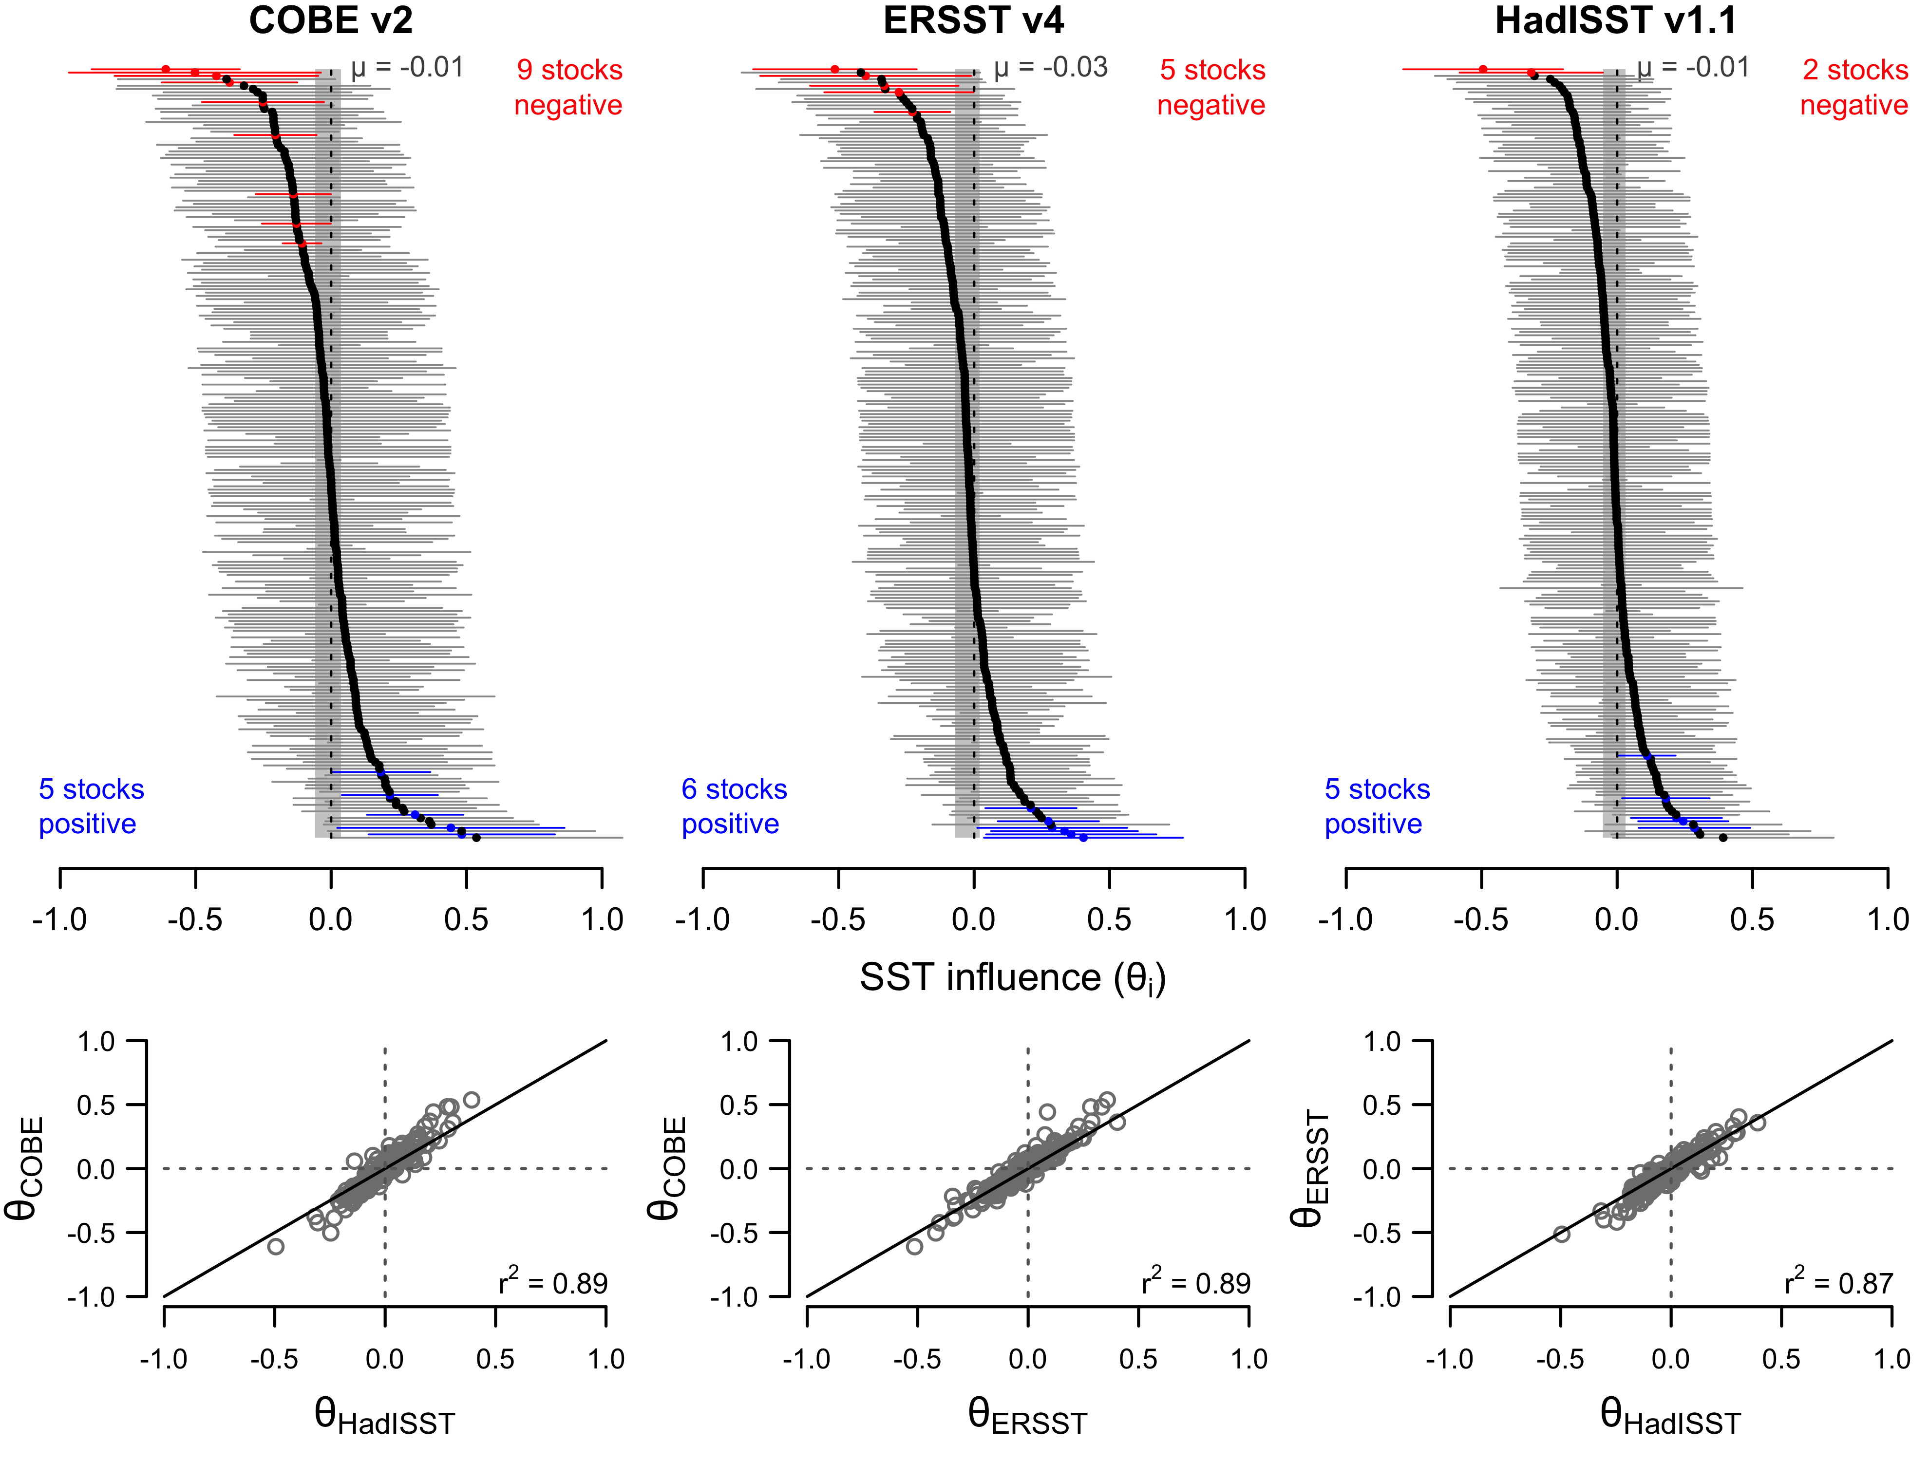

Slide 12
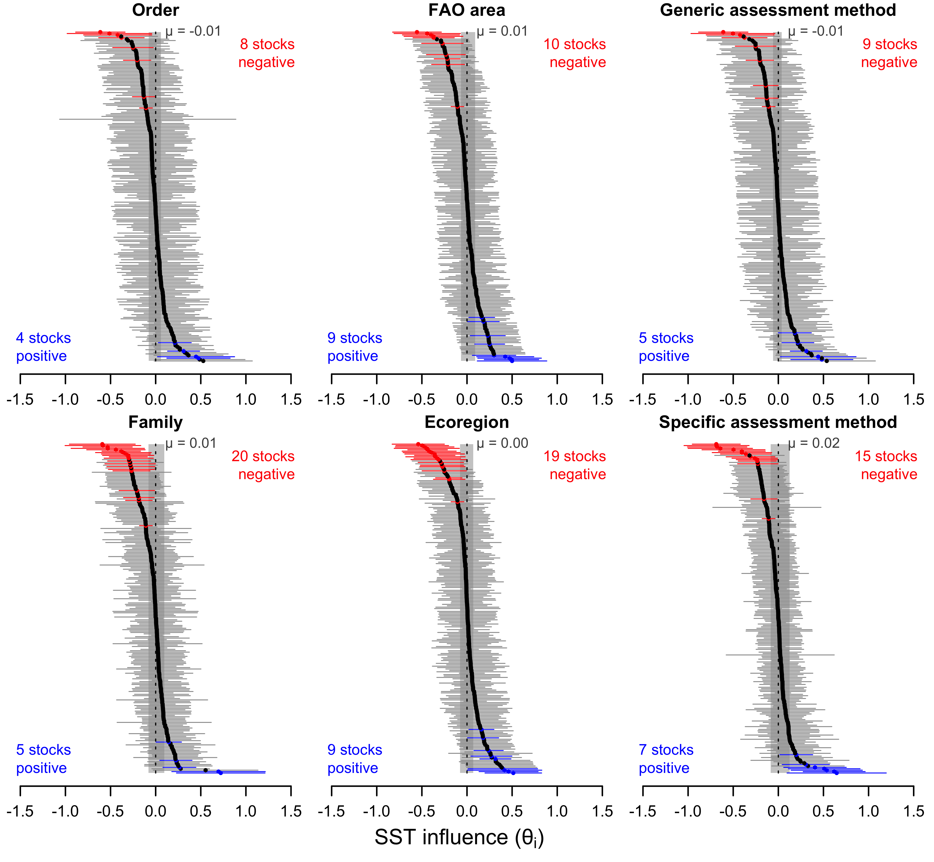

Slide 13
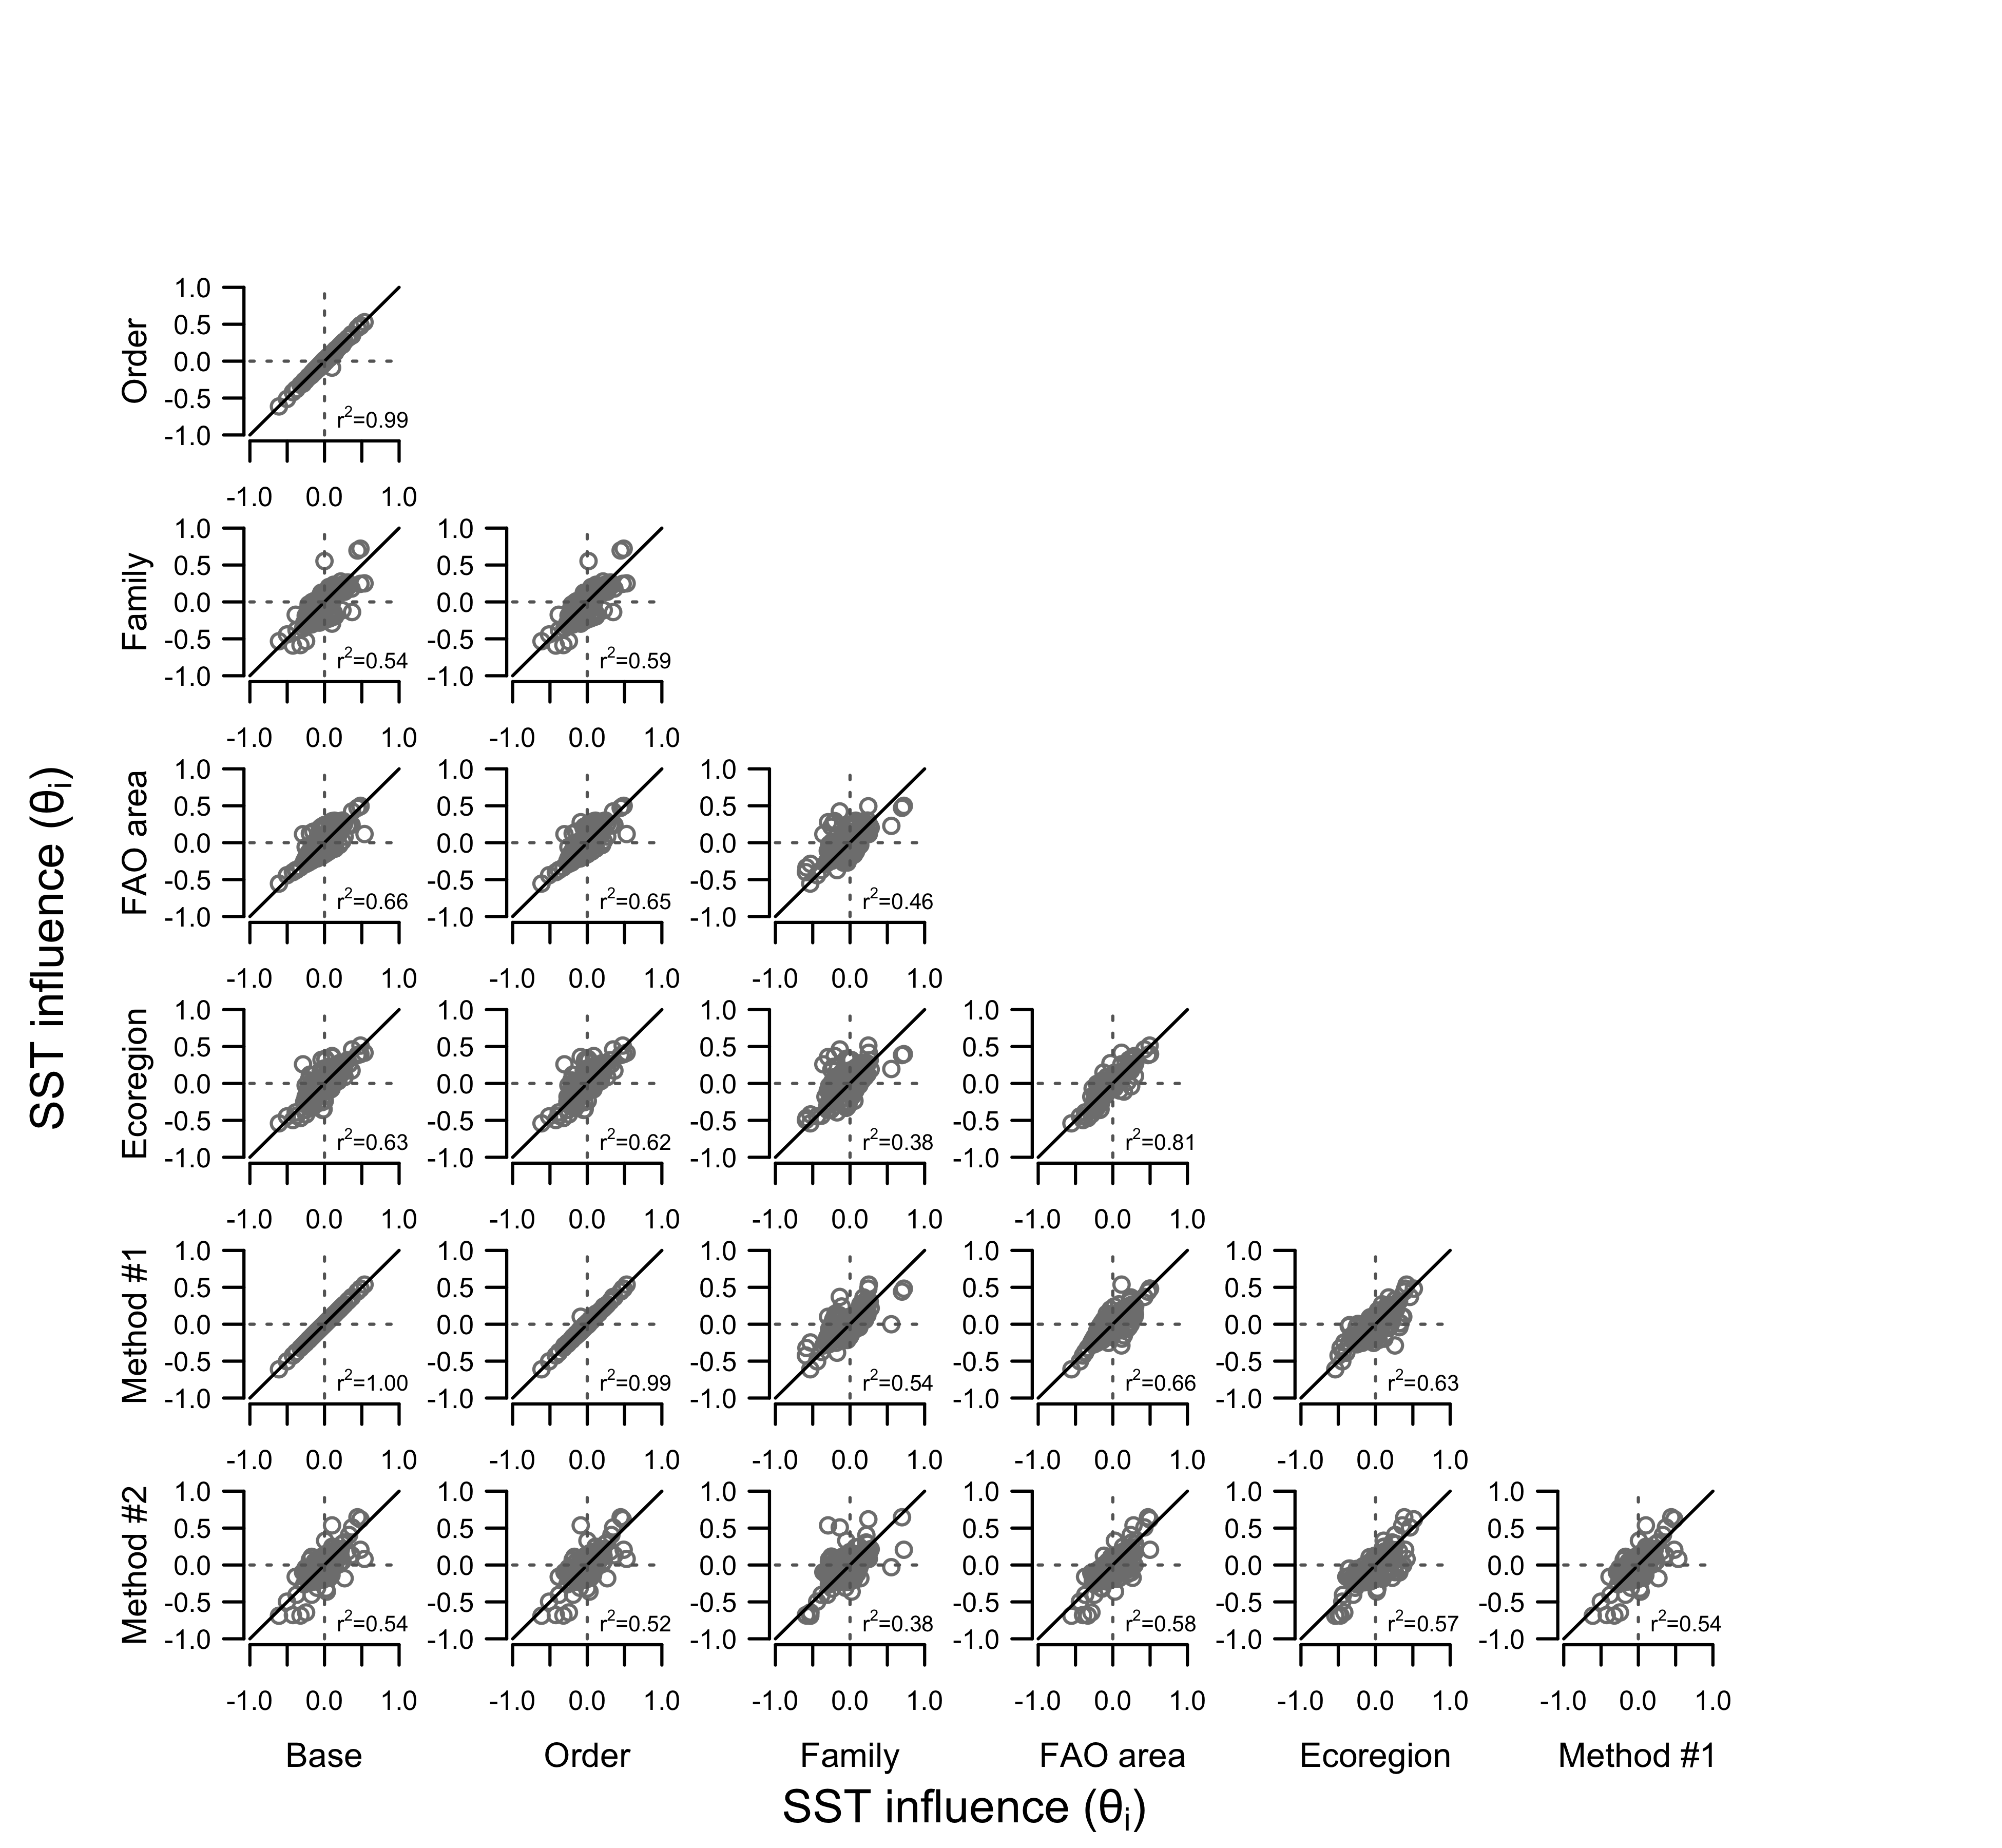

Slide 14
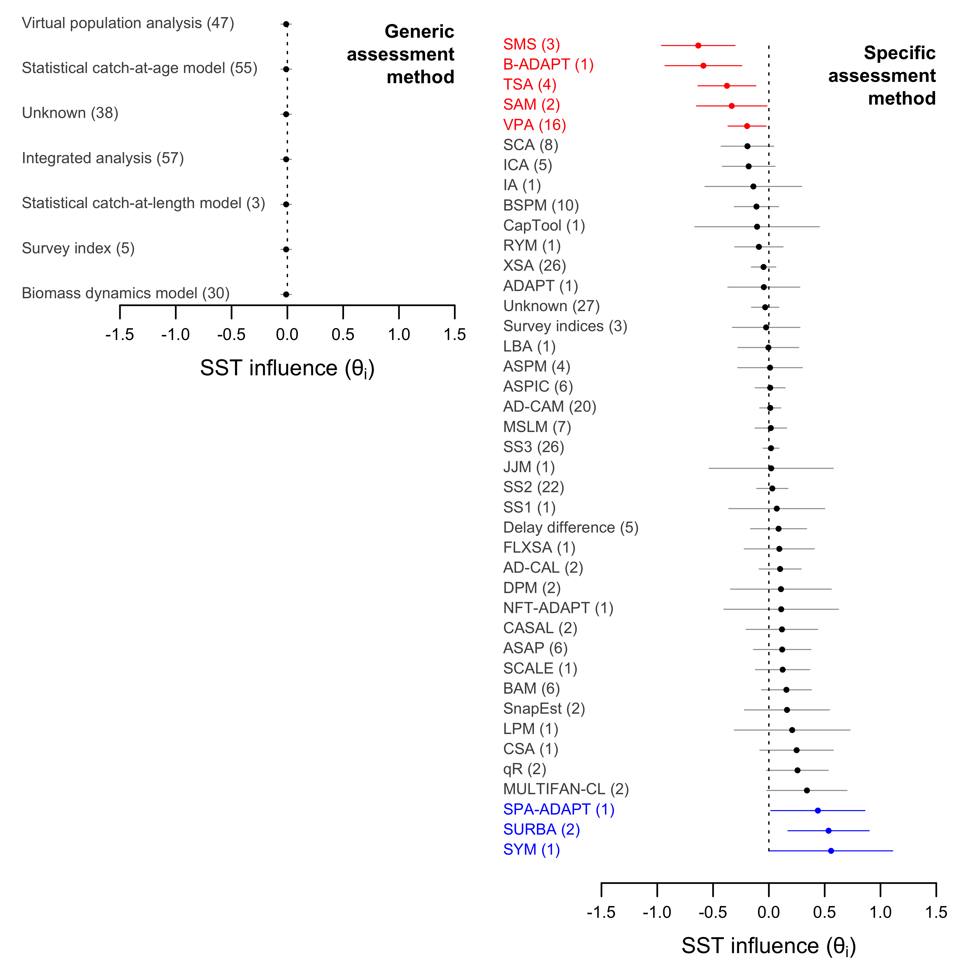

Slide 15
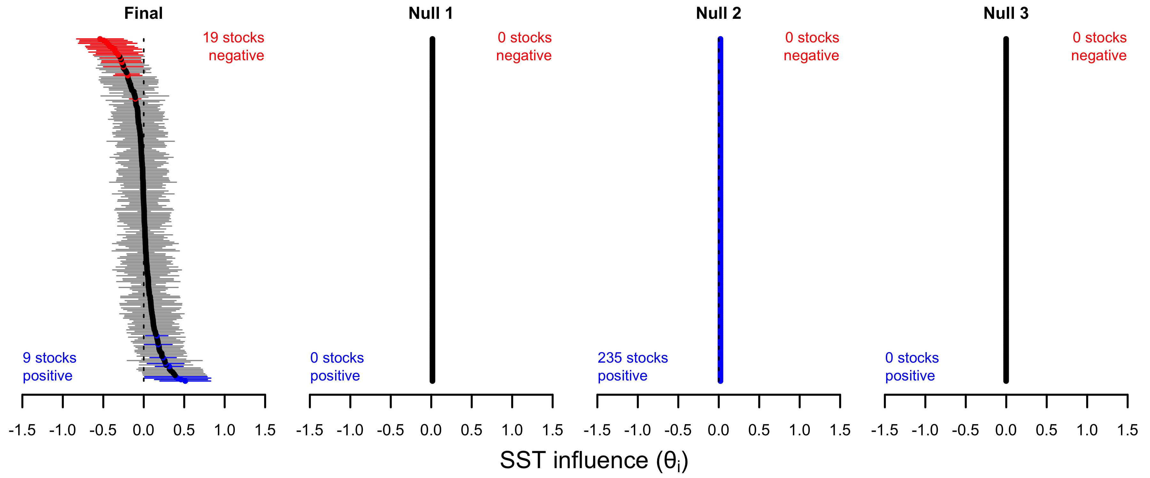

Slide 16
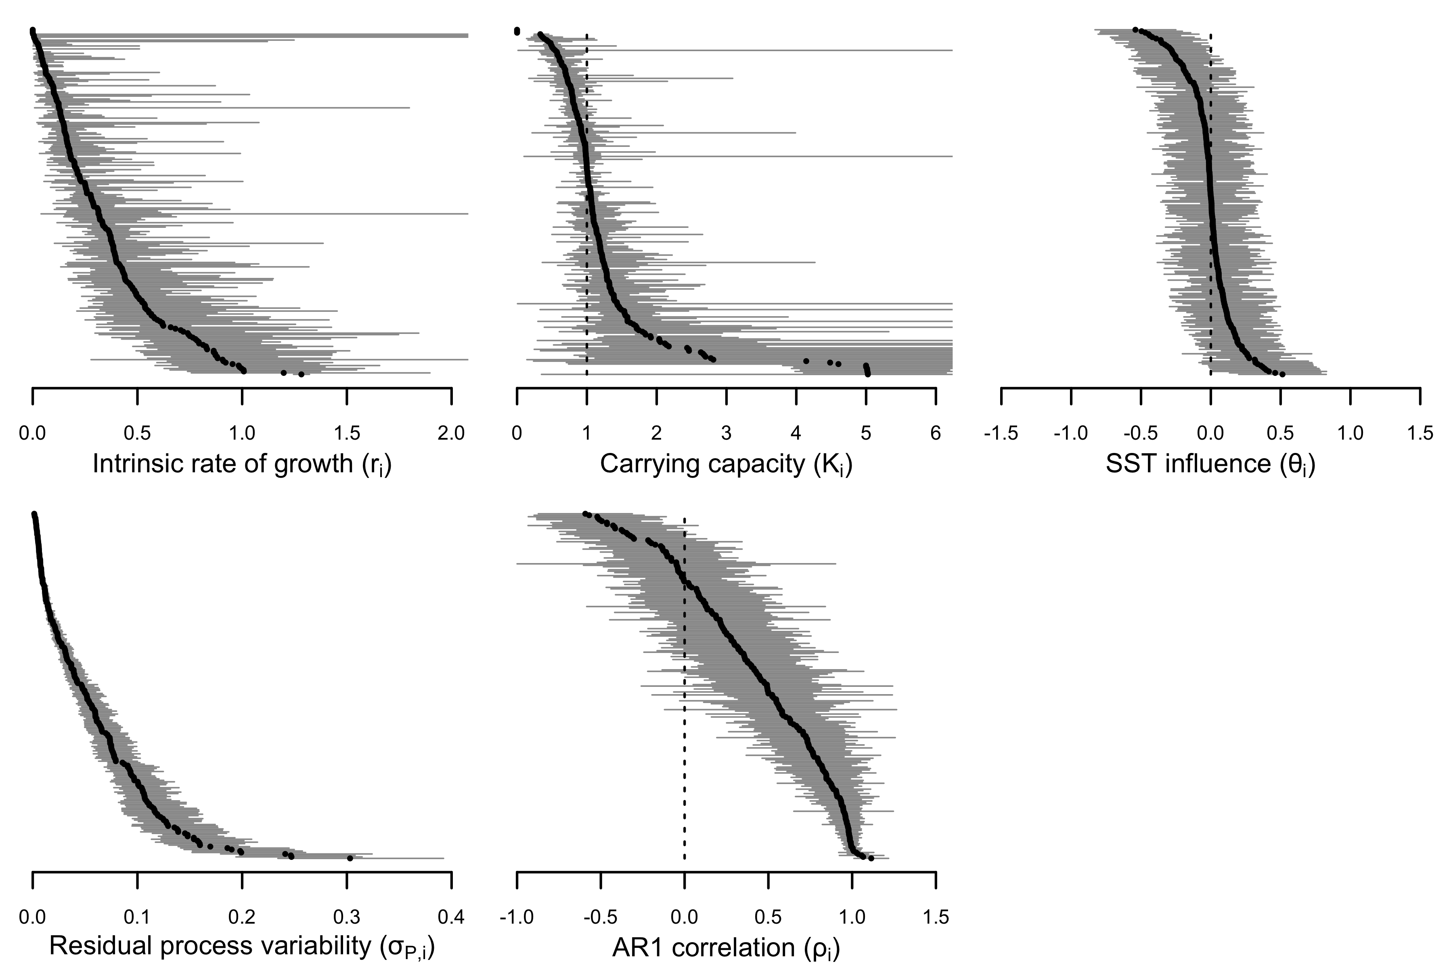

Slide 17
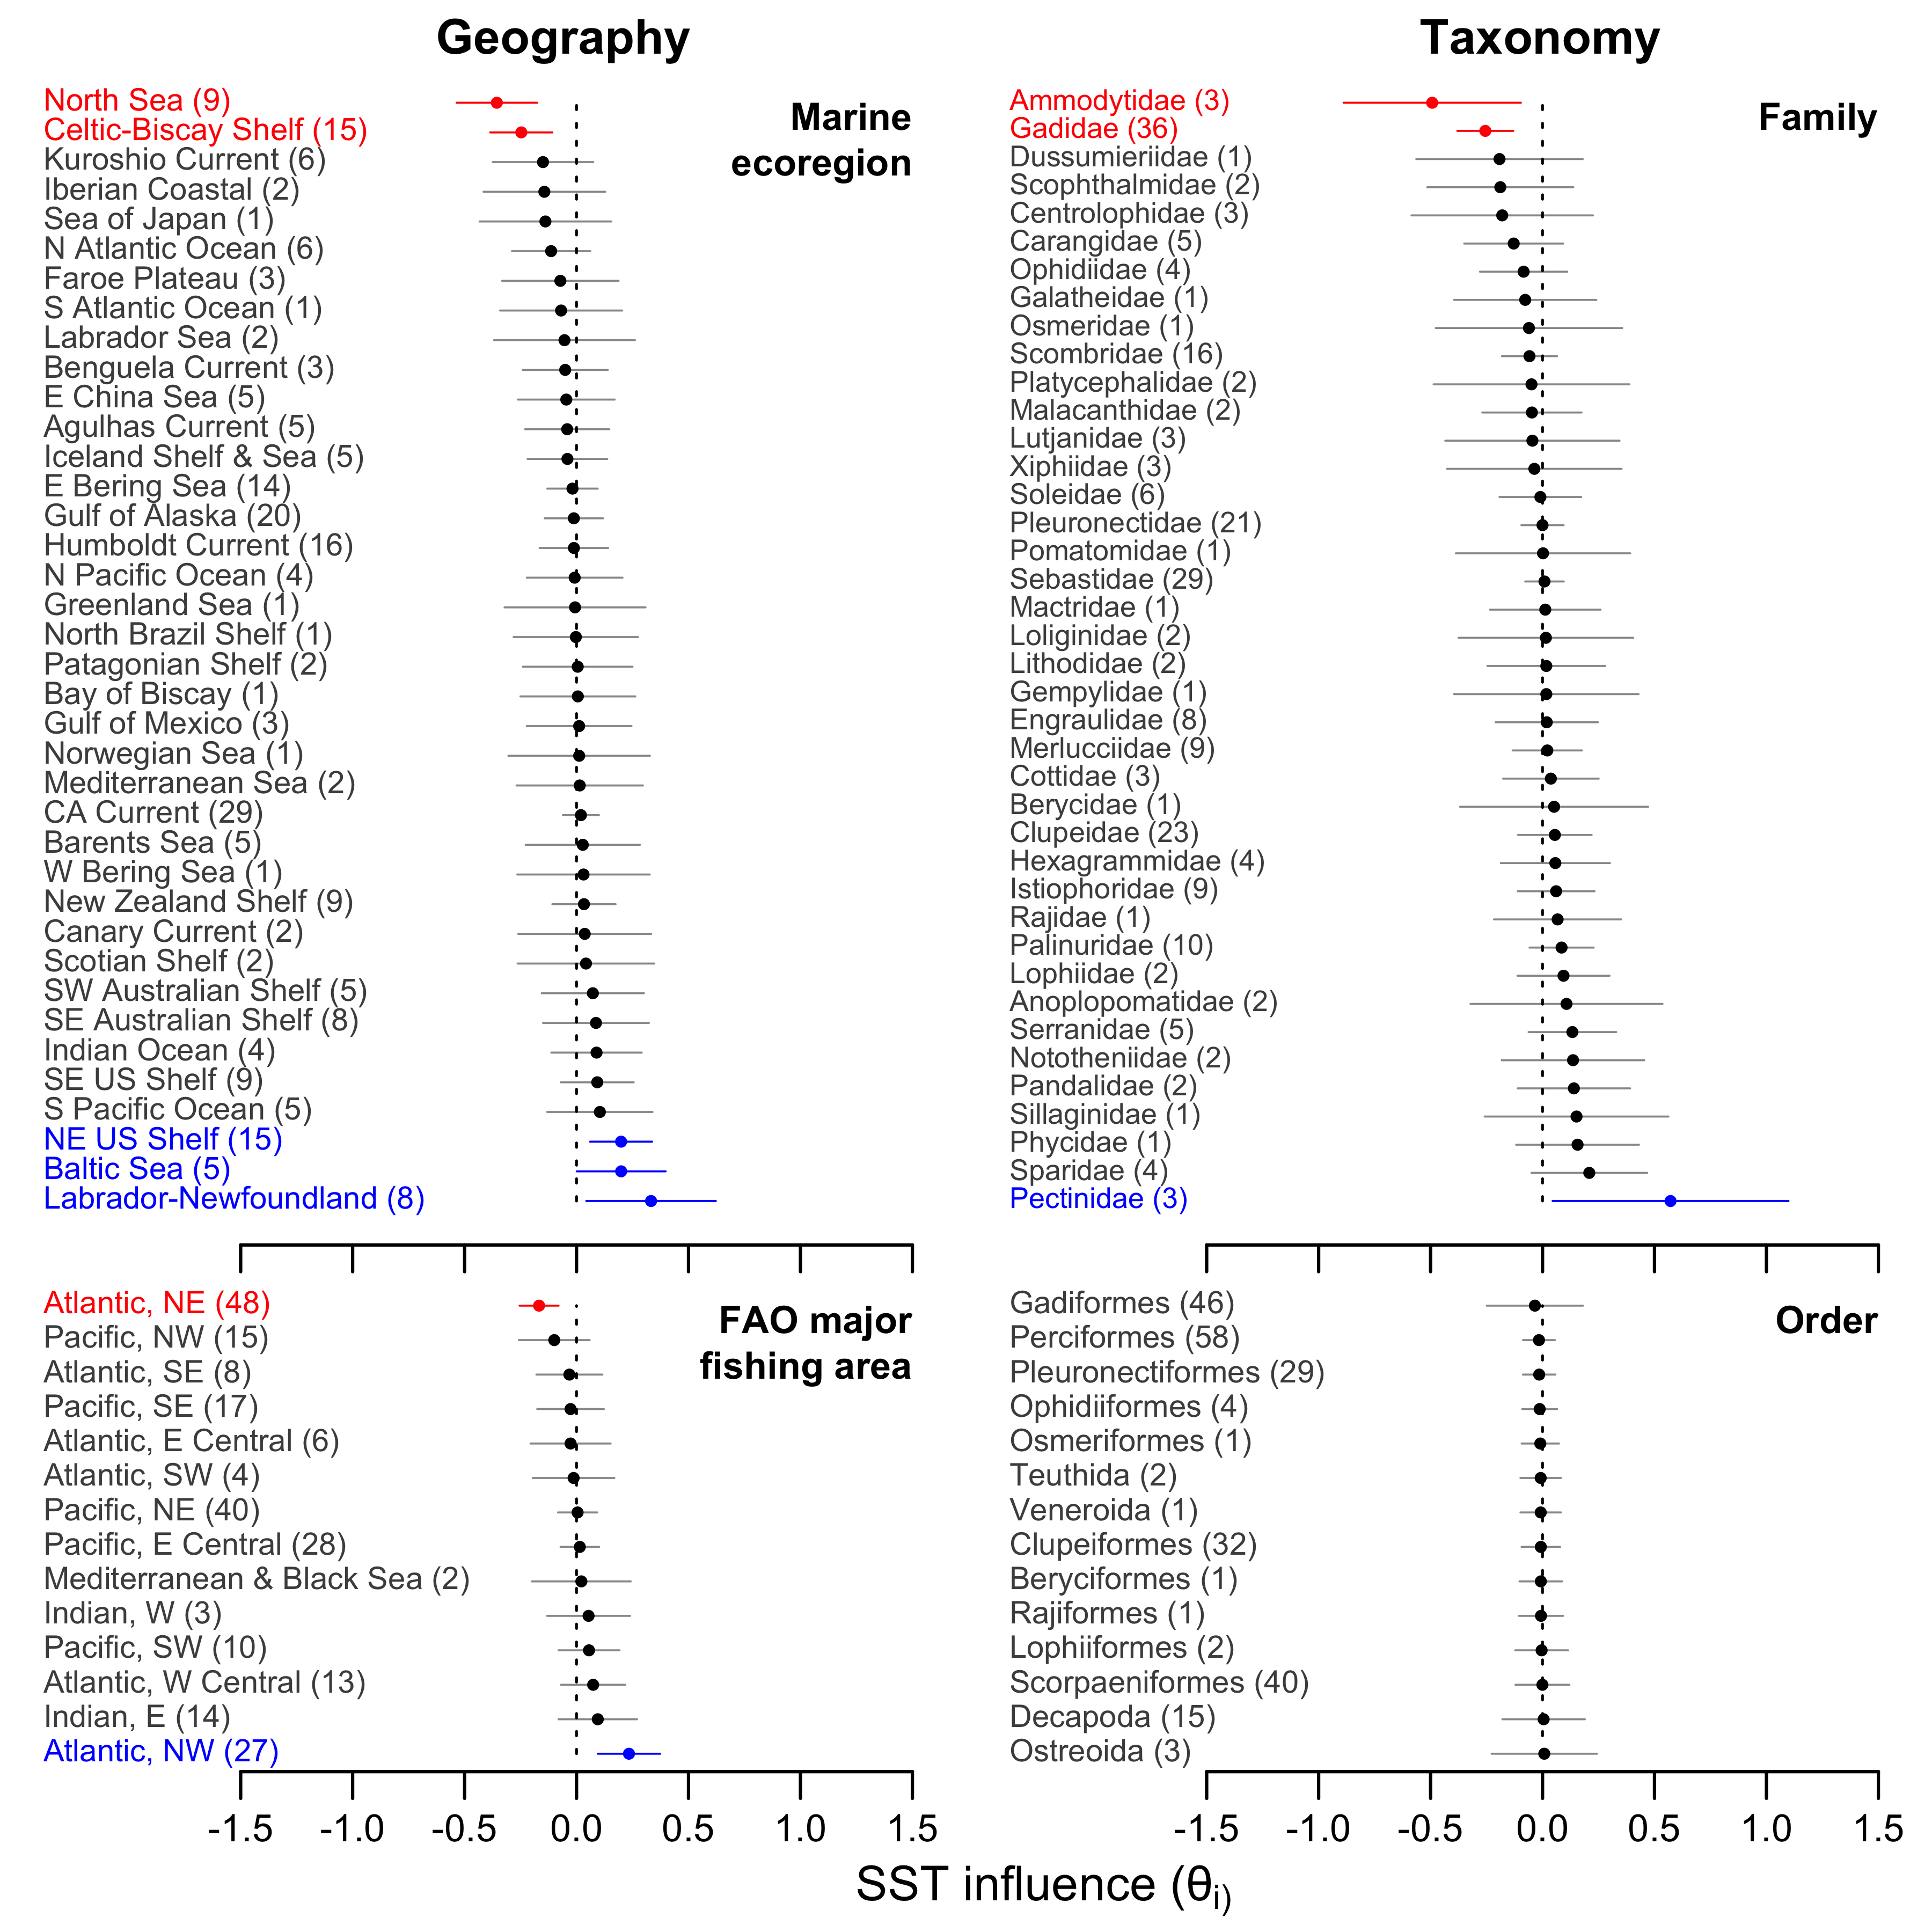

Slide 18
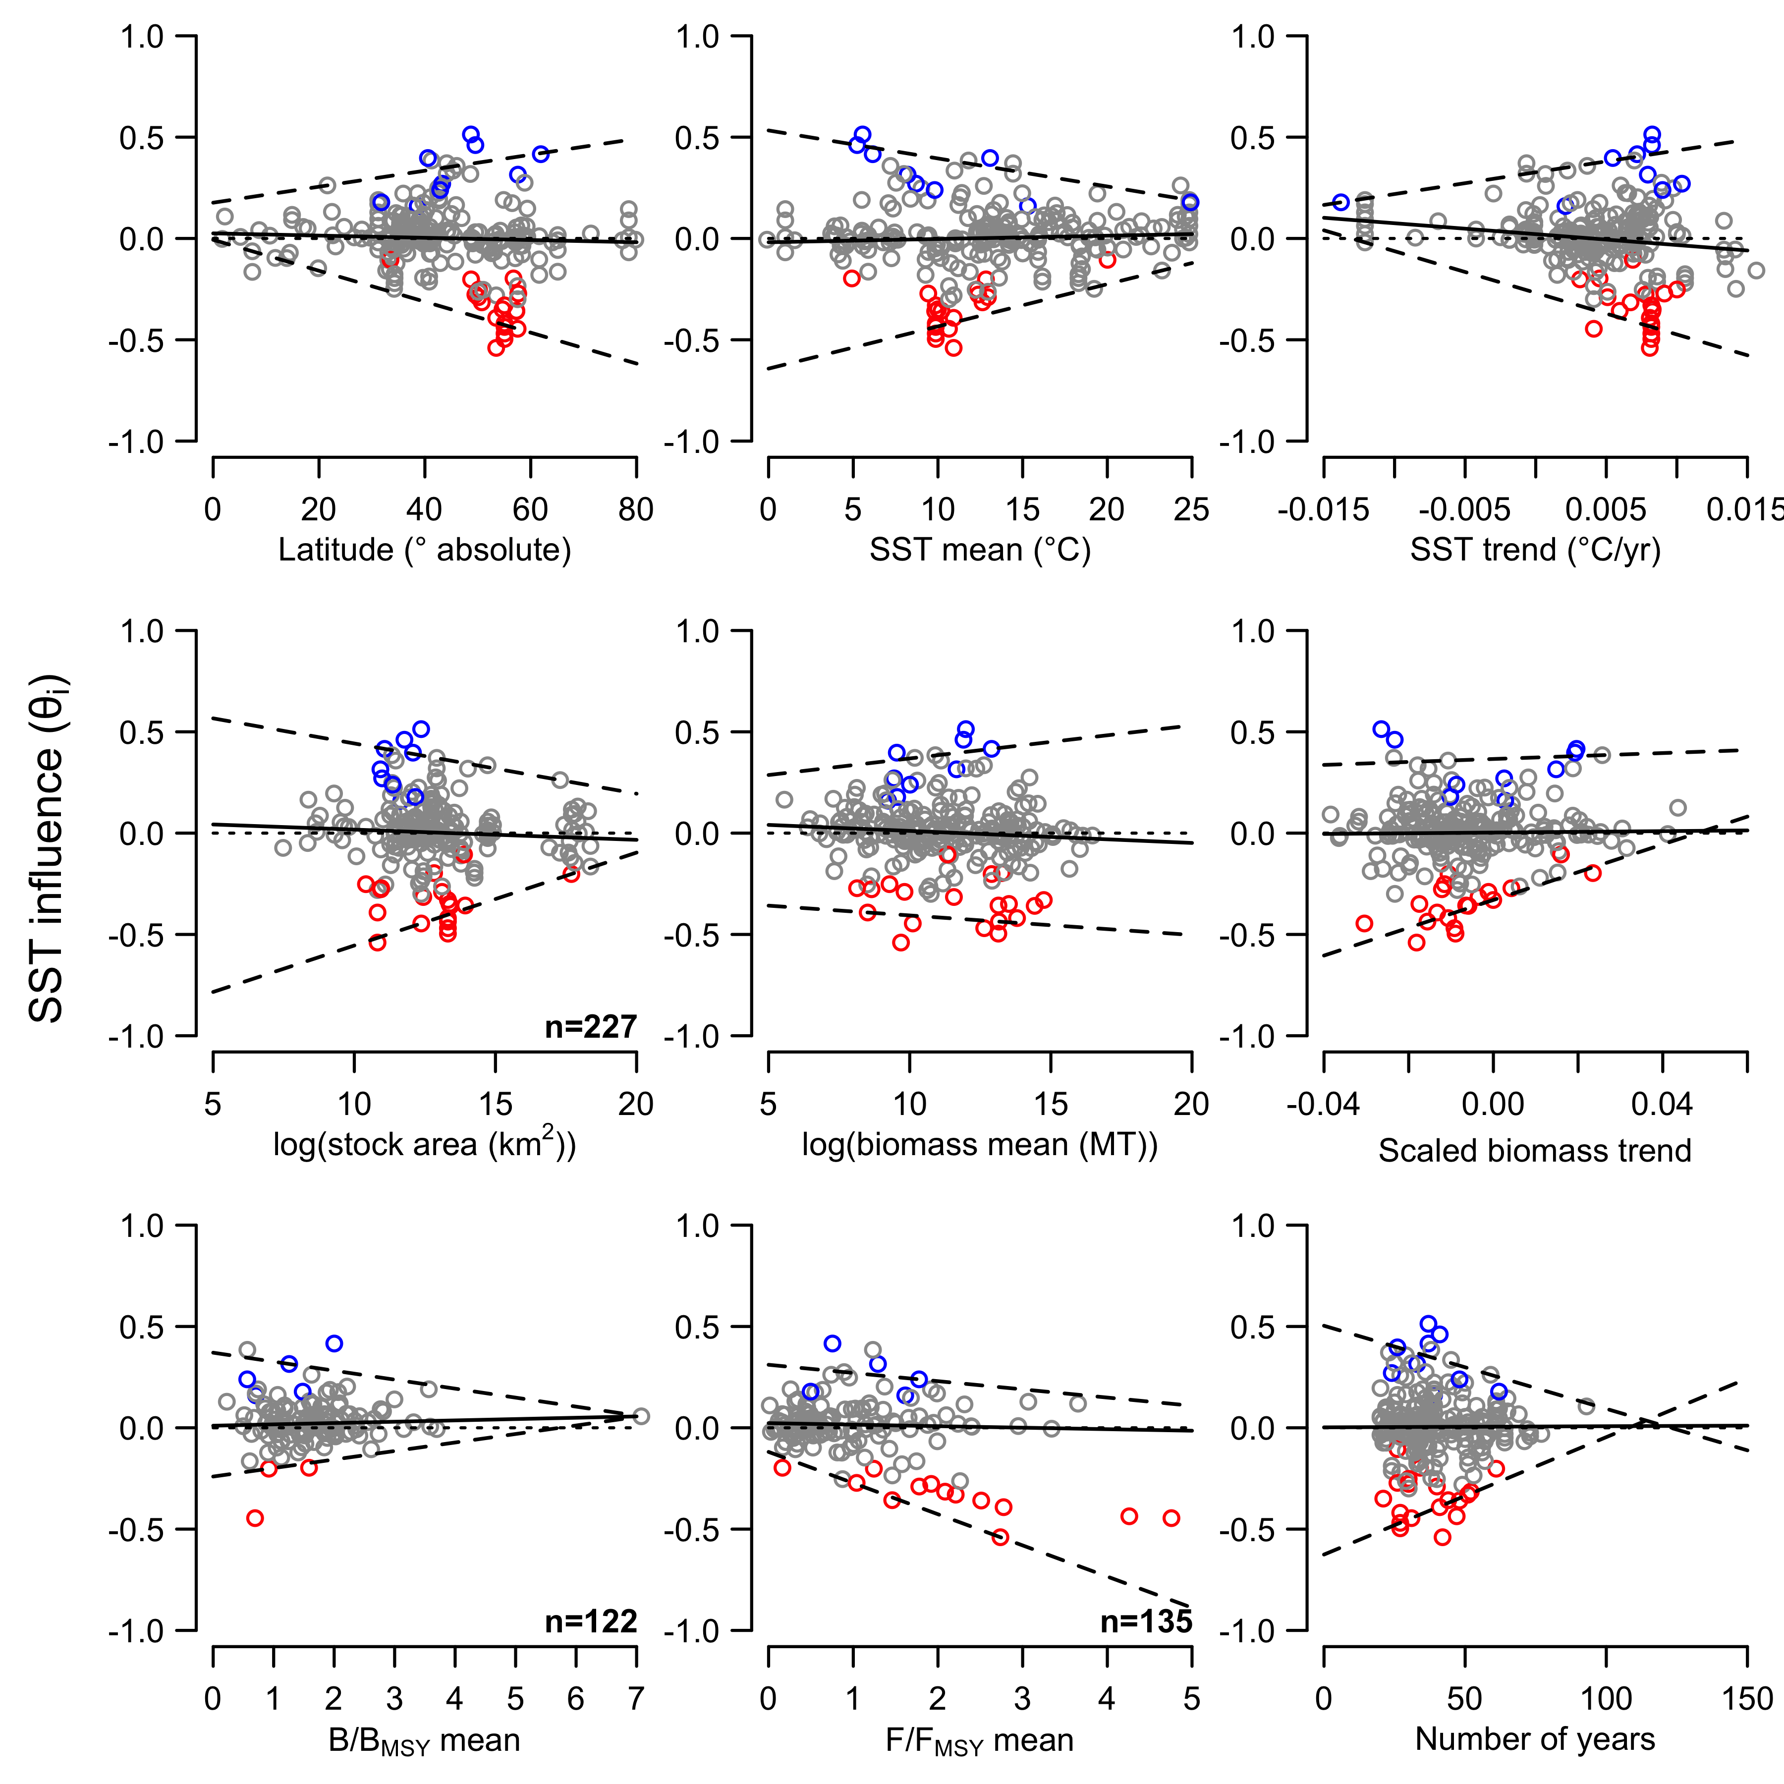

Slide 19
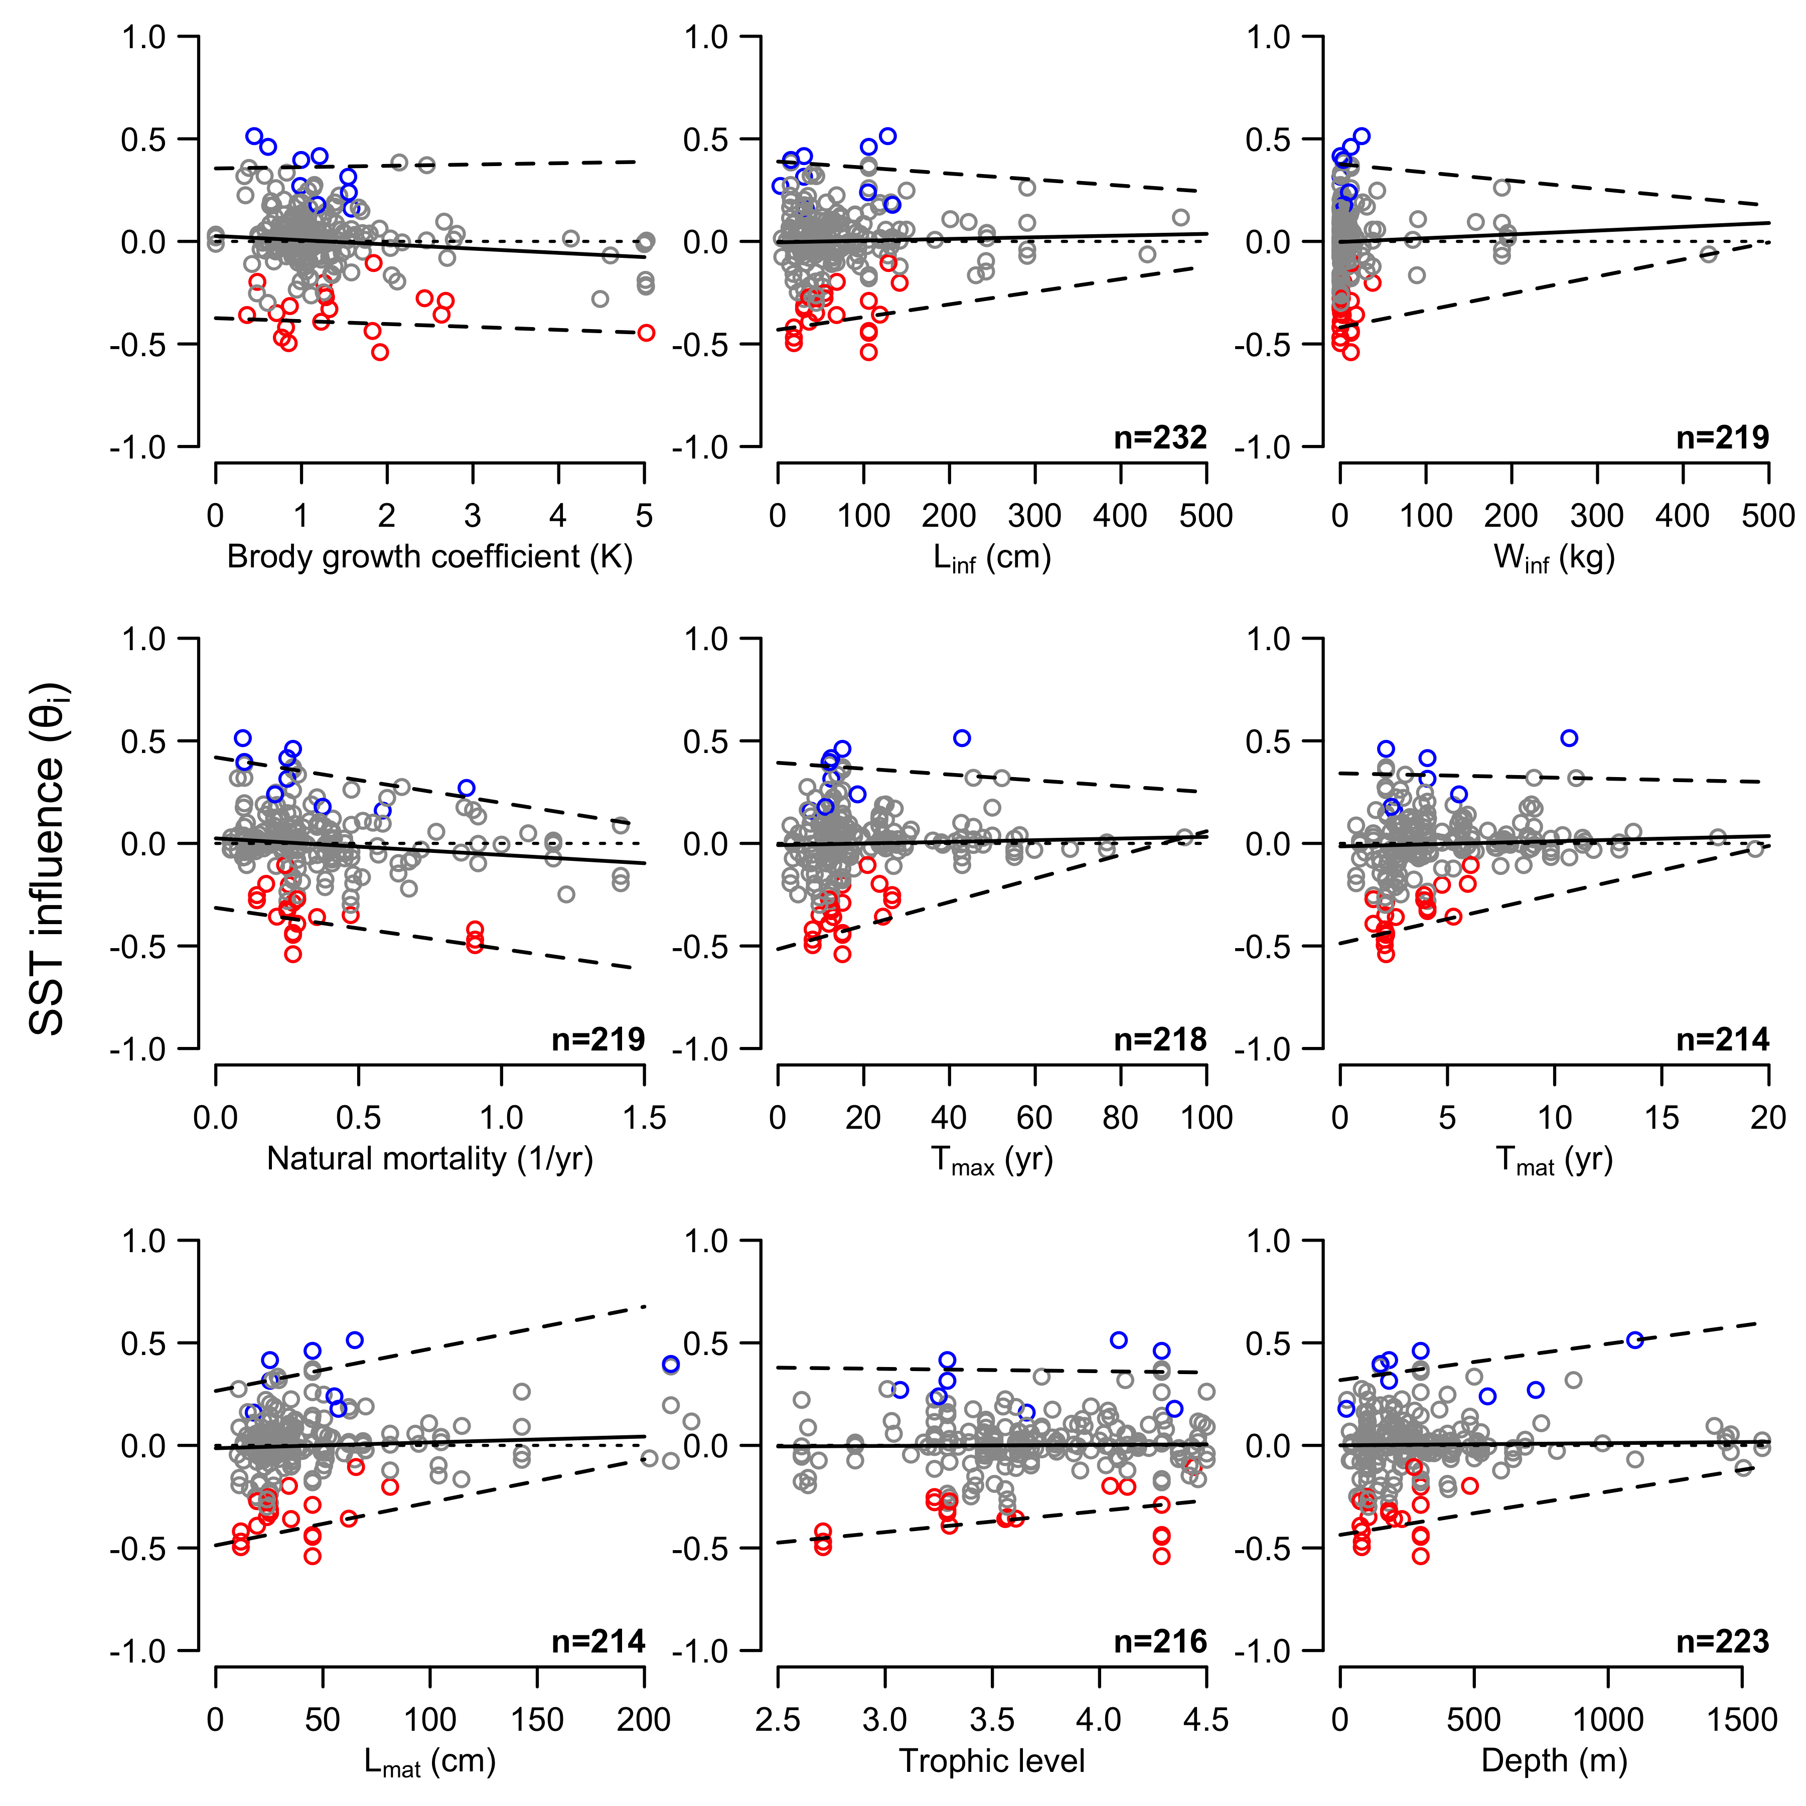

Slide 20
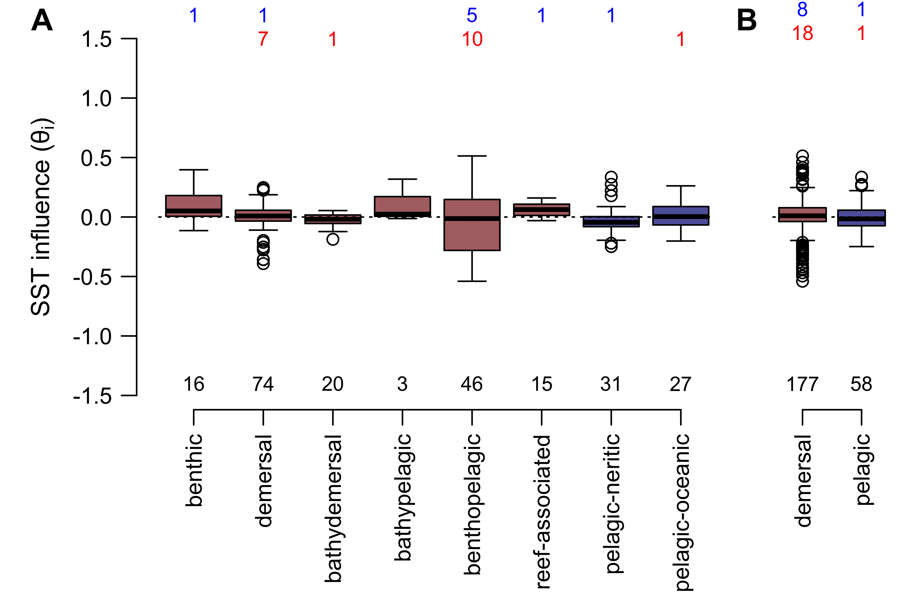

Slide 21
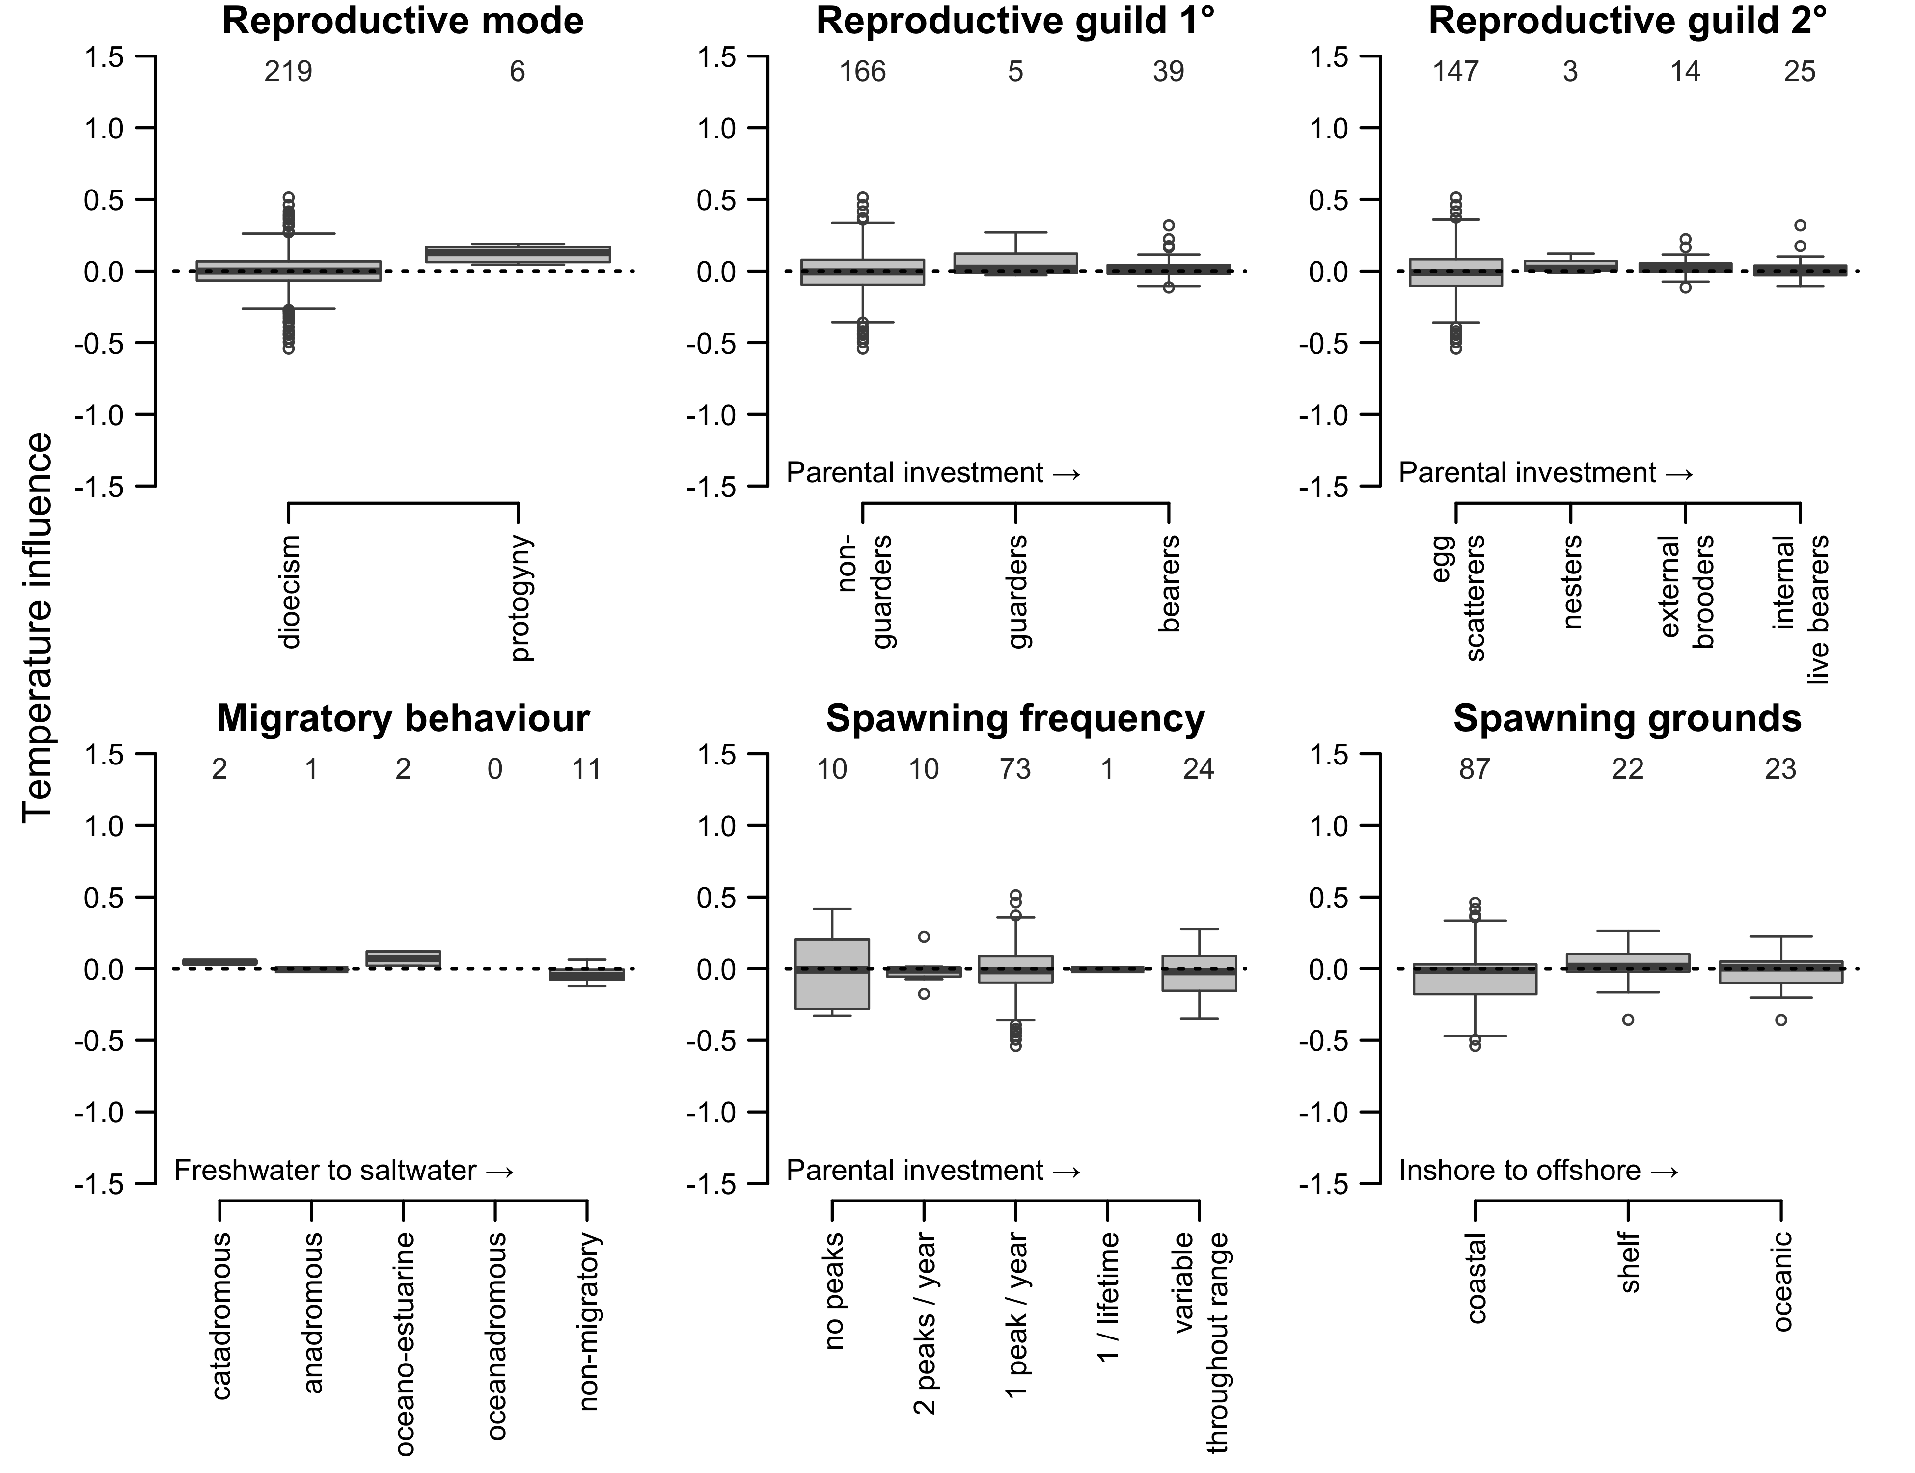

Slide 22
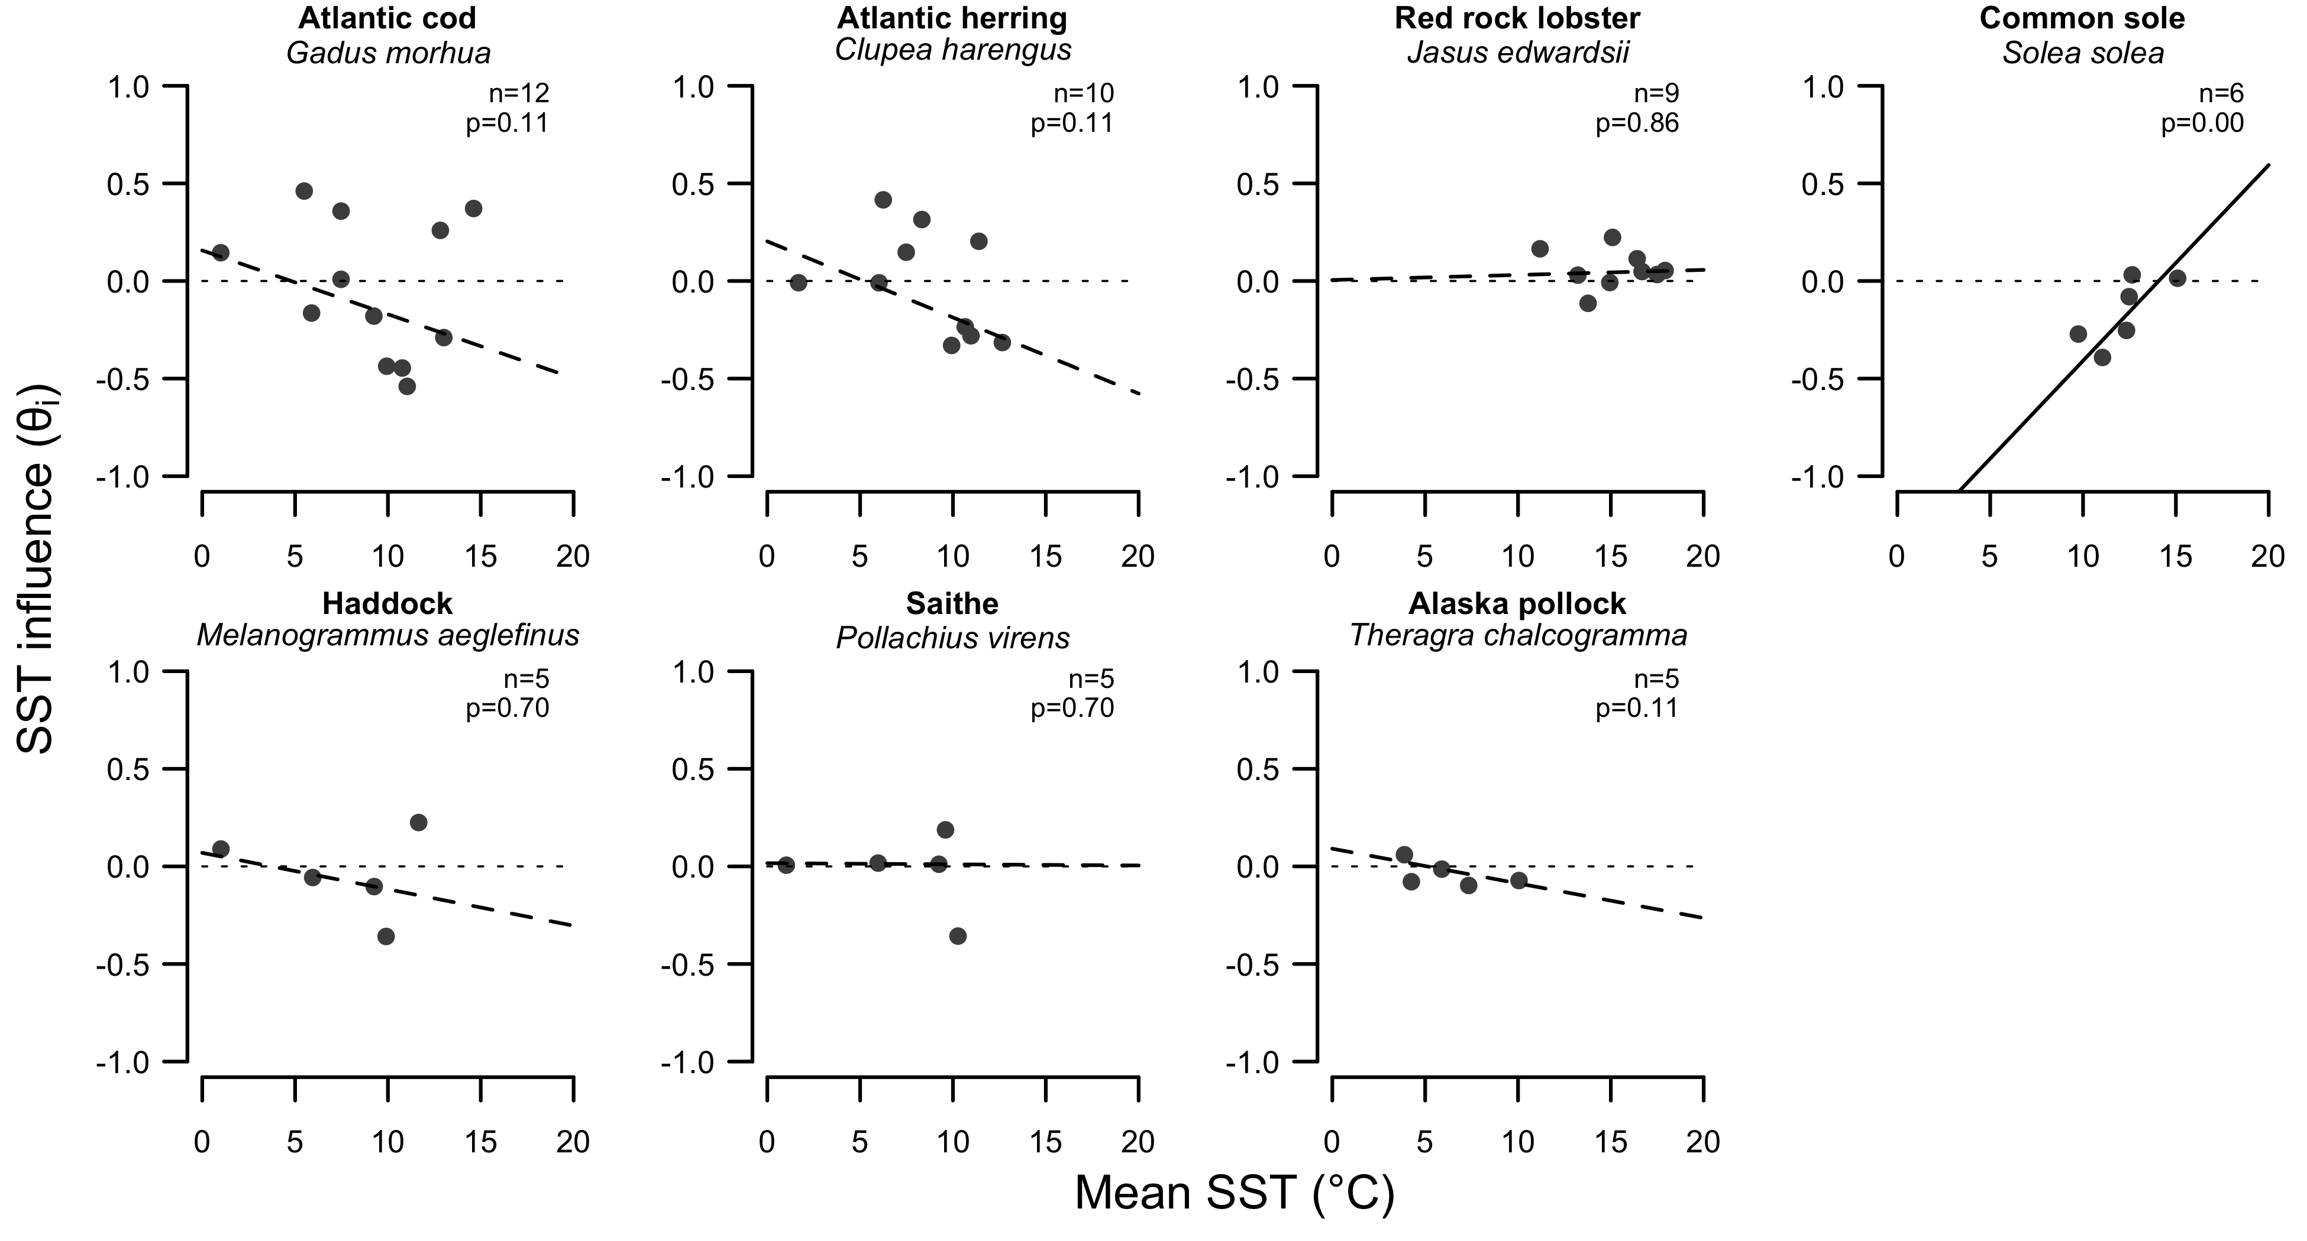

Slide 23
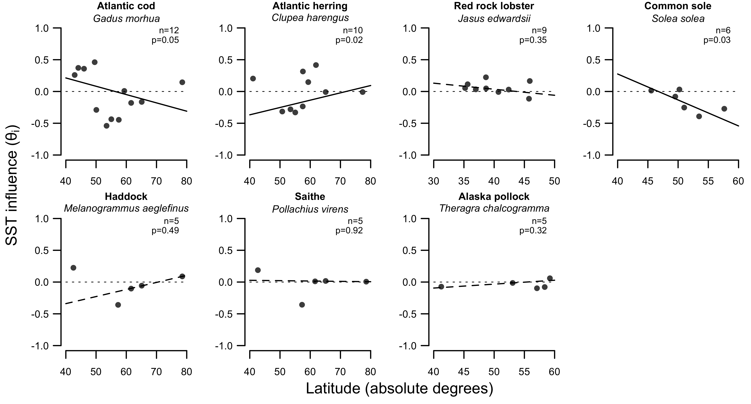

Slide 24
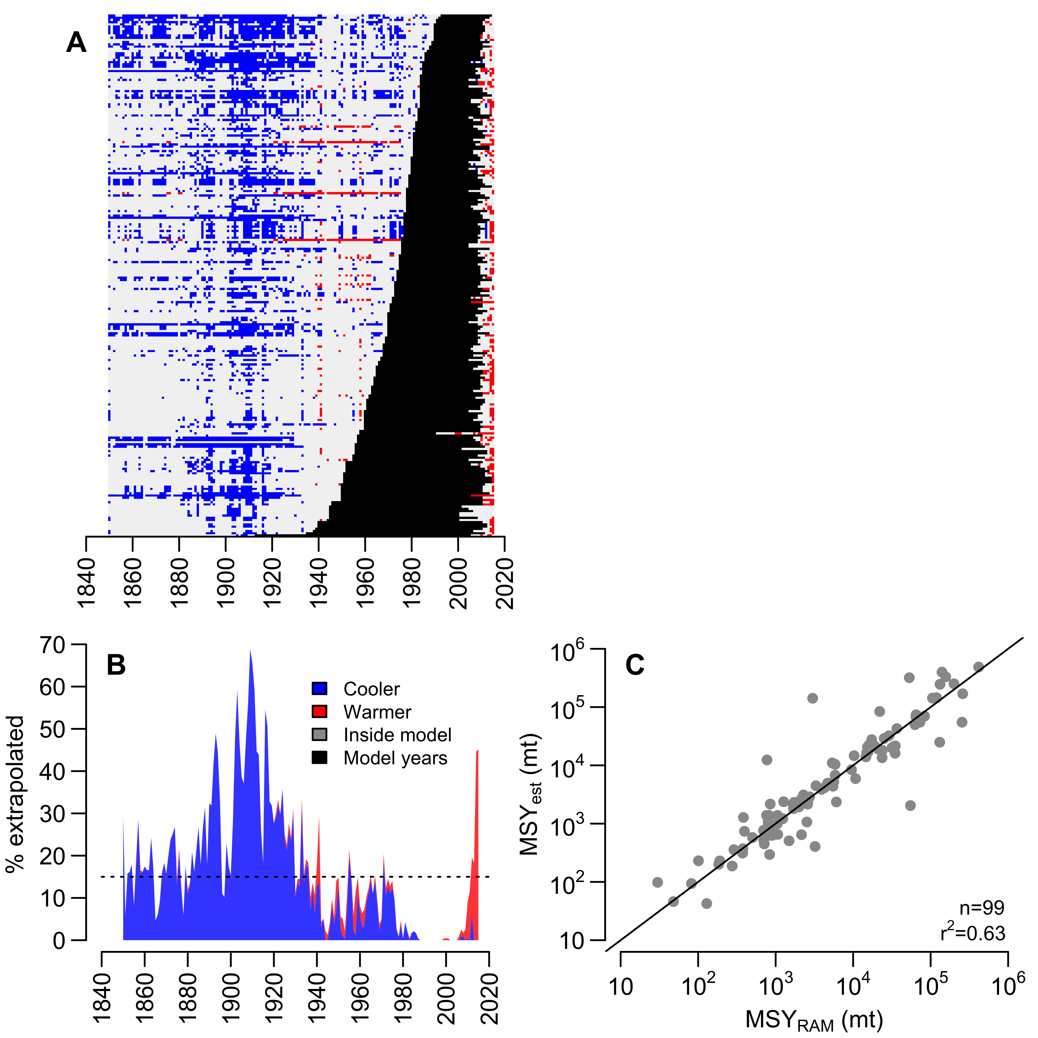

Slide 25
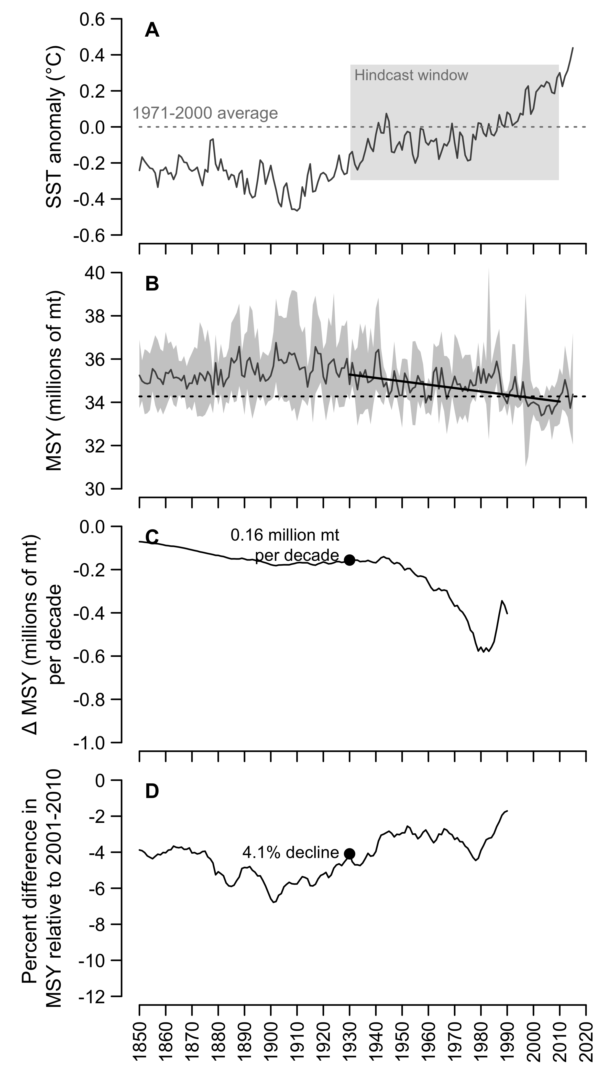

Slide 26
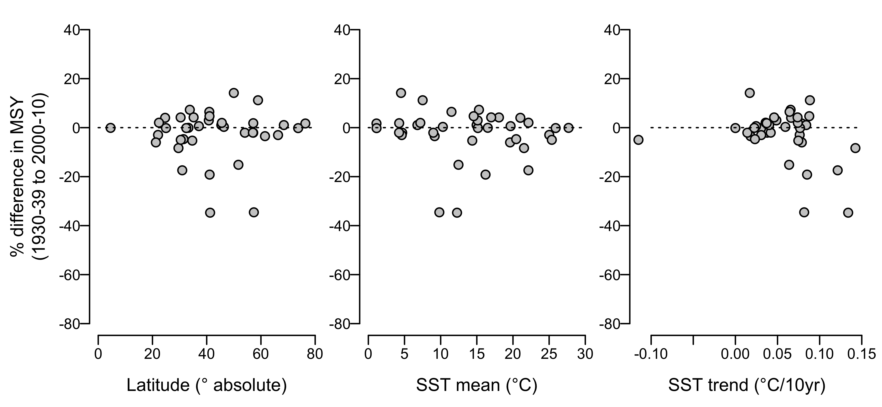

Slide 27
